Slide 1
How To Take
Equipment Inventory
2024-2025

Slide 2
Importance Of Equipment Inventory
The Food Service Division is required to conduct a biannual equipment inventory of the cafeteria to determine what equipment is at each school site.
The equipment inventory:
Manages equipment effectively, utilizing known quantities/numbers.
Develops realistic plans for future purchases.
Ensures that funds are not wasted procuring new equipment, while neglecting the replacement of existing equipment.

Slide 3
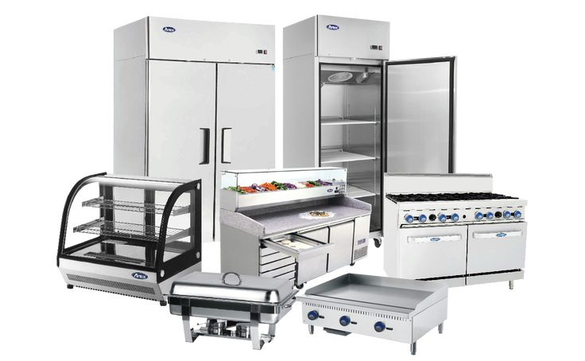
How to Complete the Equipment Inventory
It is the managers responsibility to physically identify each piece of equipment from the “Master Inventory Report” that is given by the Food Services Equipment Team.
Each piece of equipment listed on the report must be documented.
You must match the:
Description
Model
Serial
Board
#
#
#

Slide 4
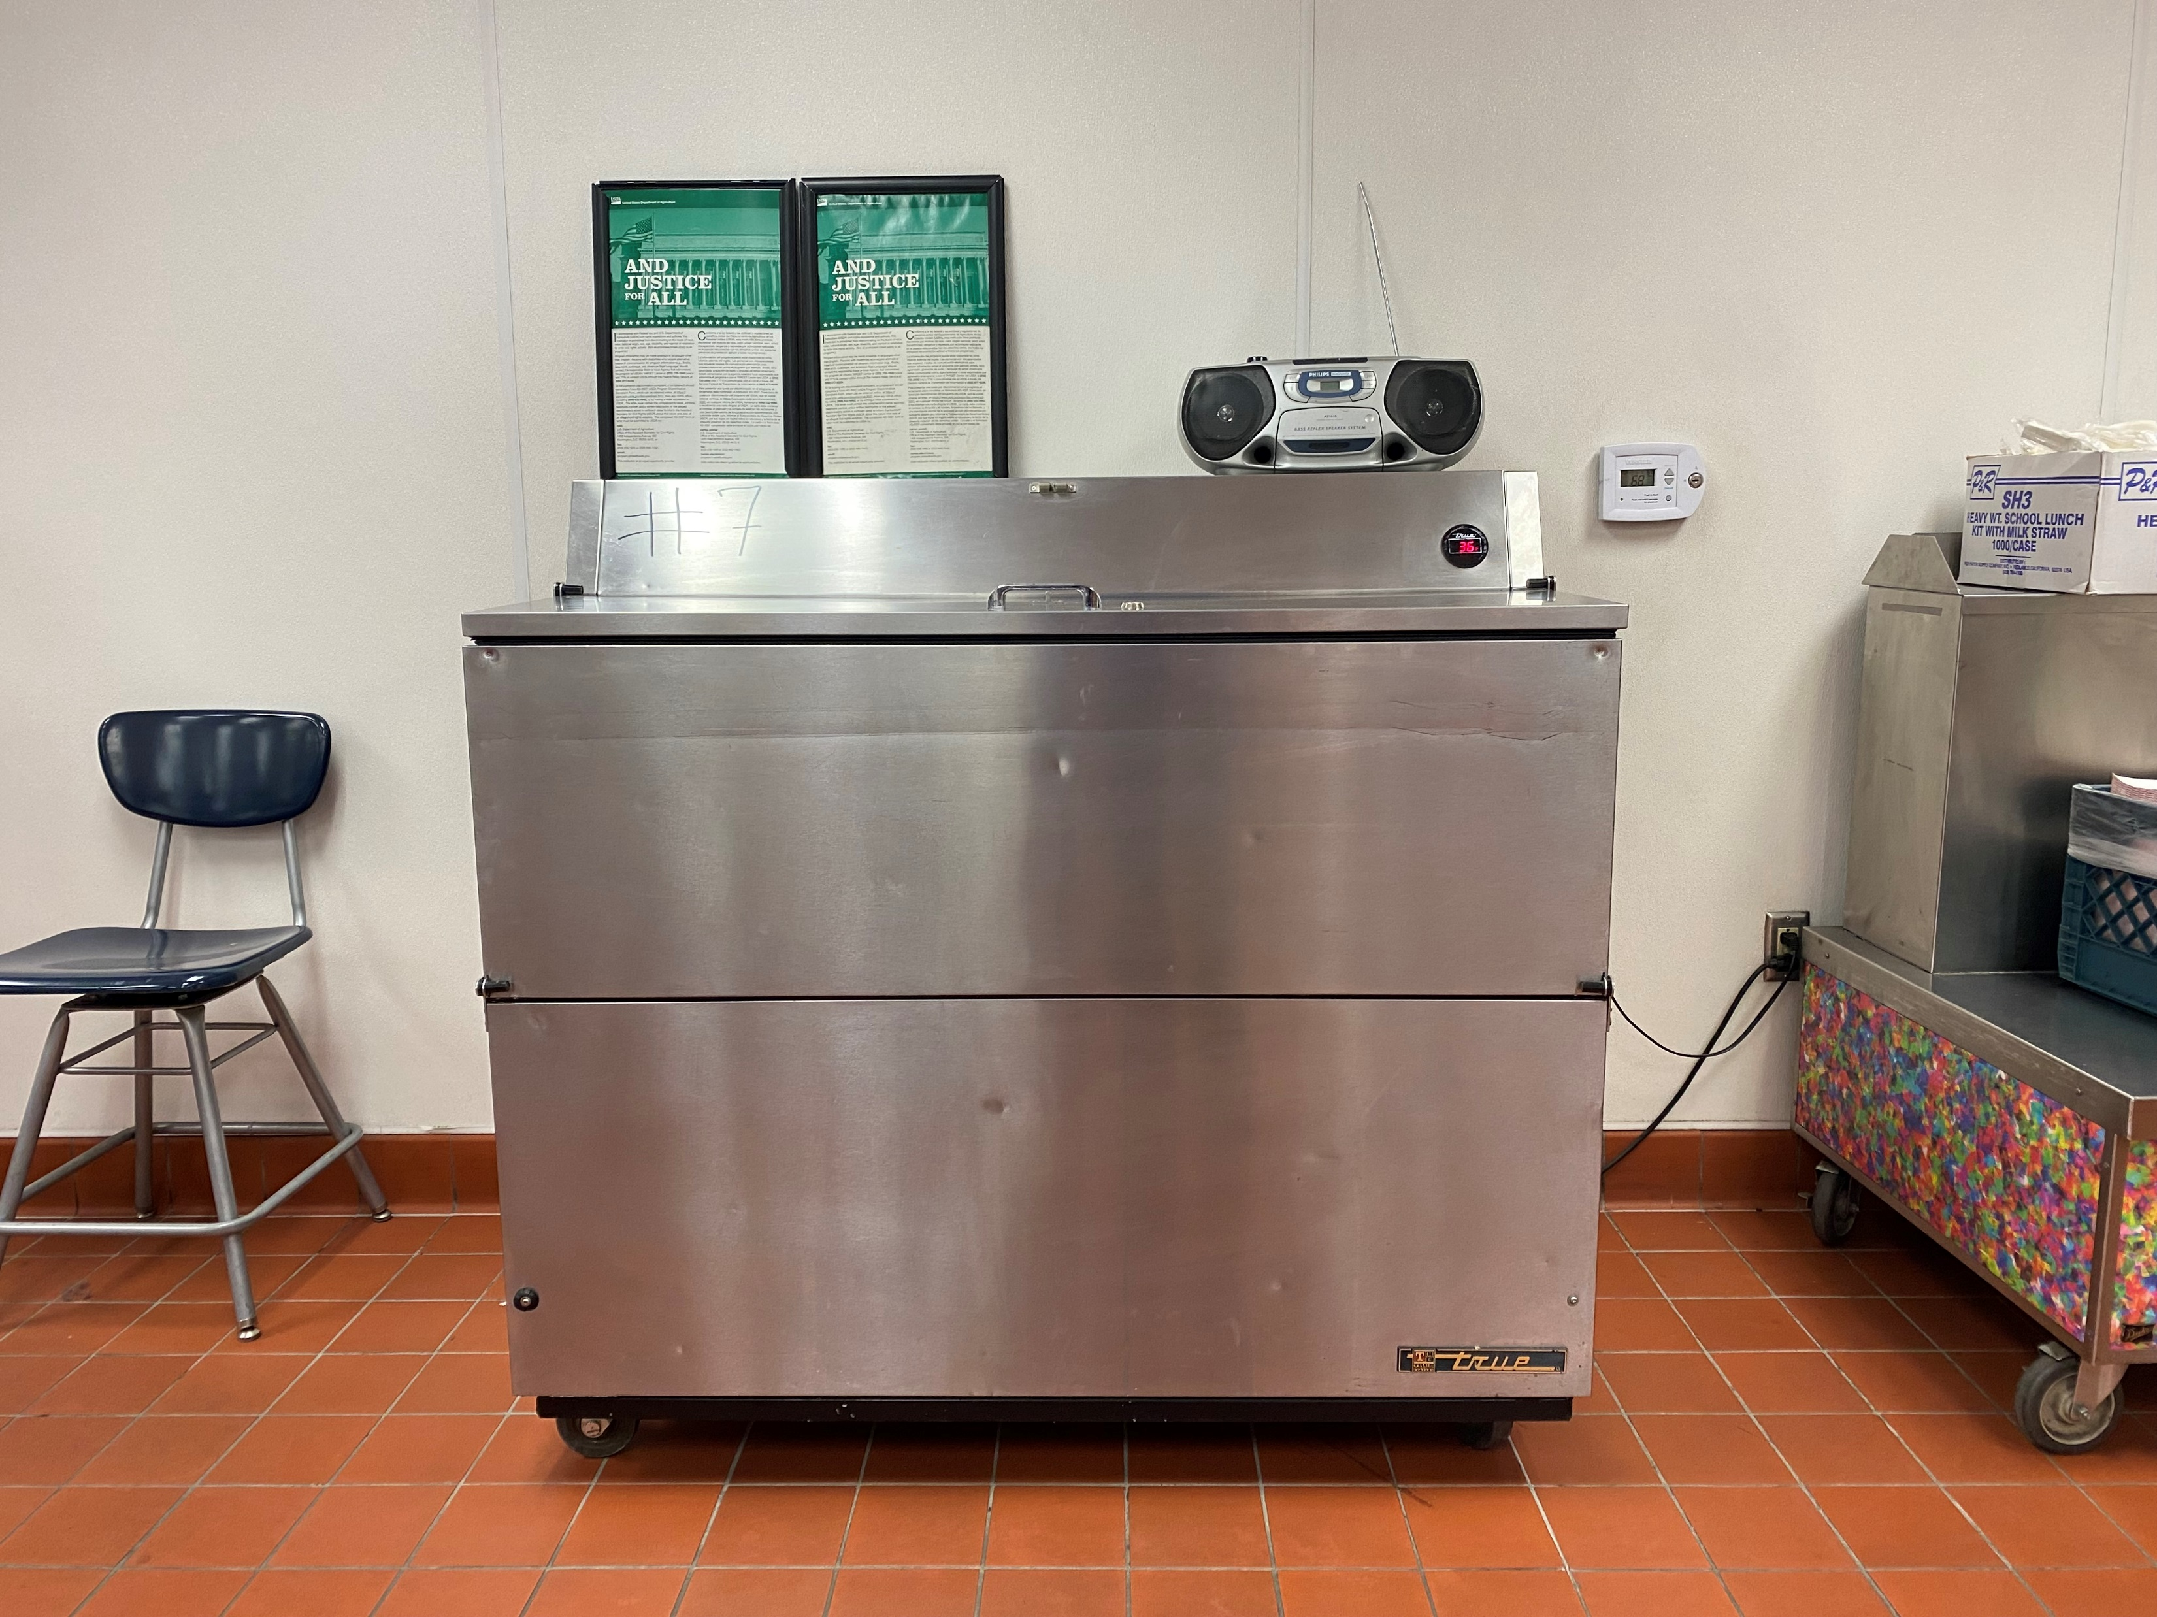
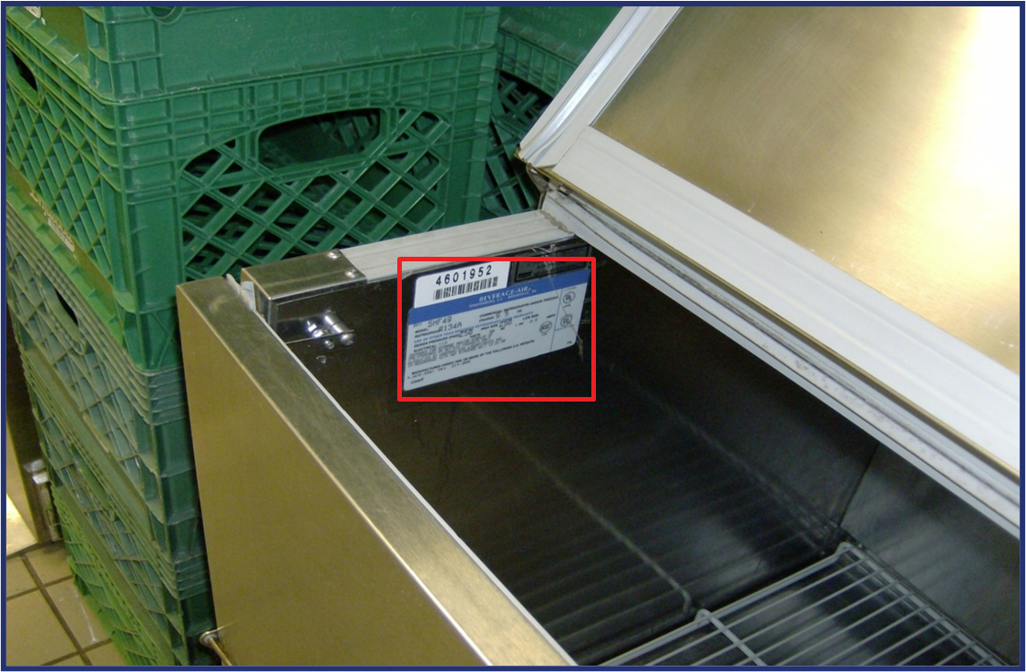
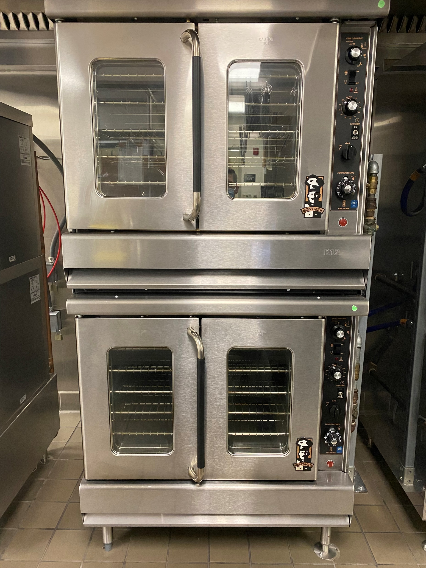
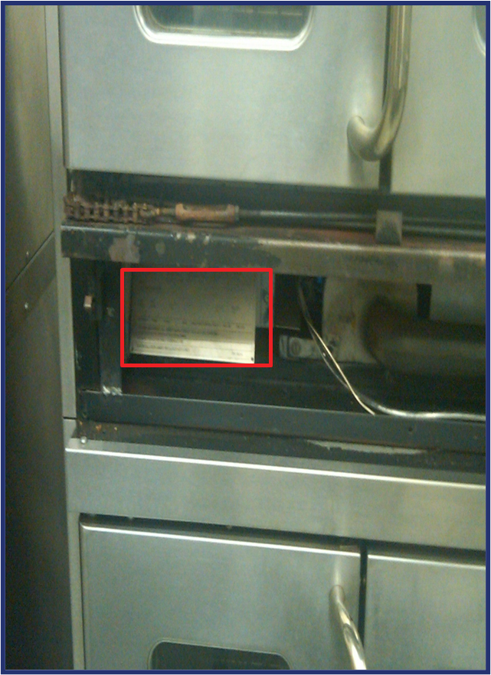
Tracking Serial, Model, and Board Numbers
Serial and model numbers will be in specific areas depending on type of equipment.

Slide 5
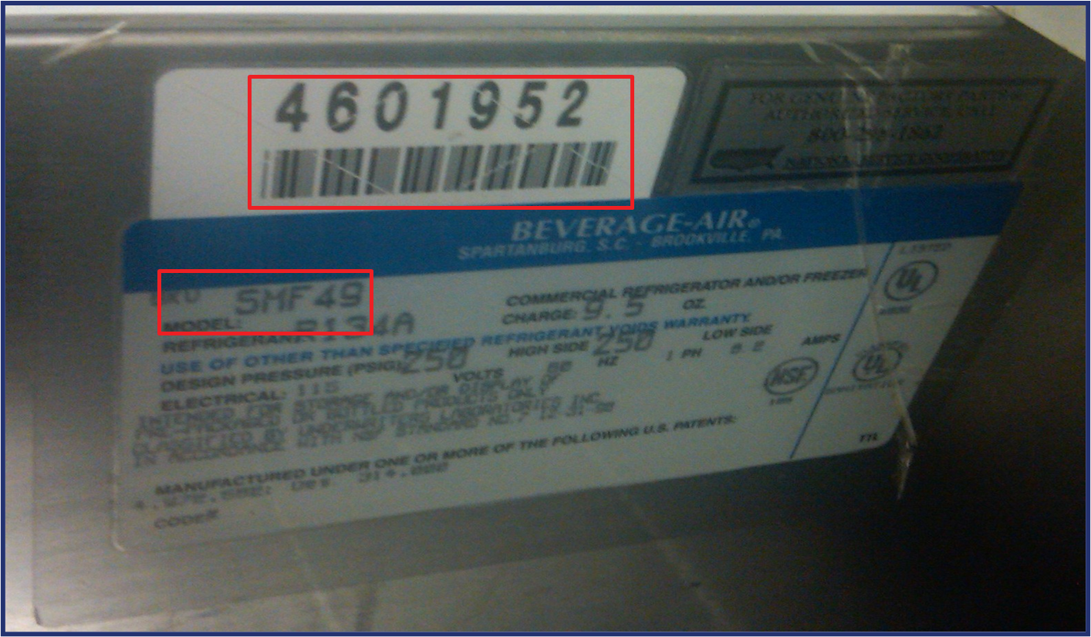
Example Model And Serial Number Information
Serial Number: will be displayed in a numerical combination
Model Number: will be displayed as numerical and alphabetical combination.
Serial #.
Model #.

Slide 6
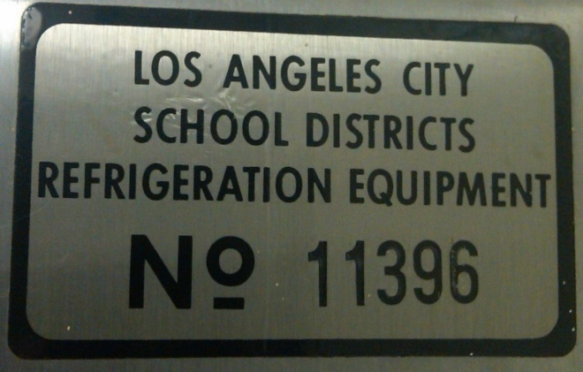
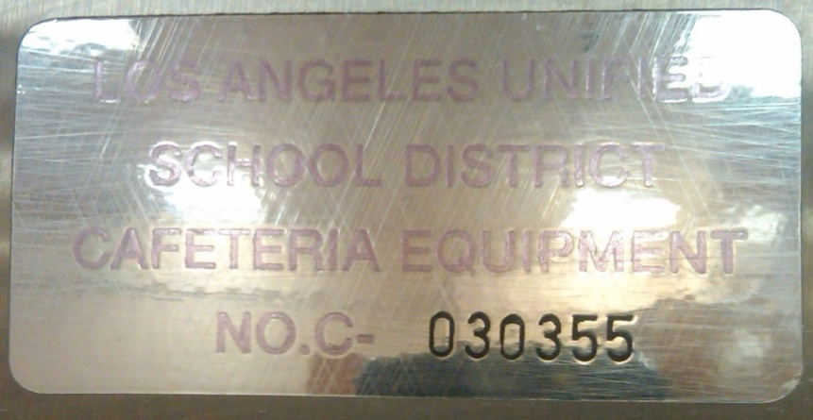
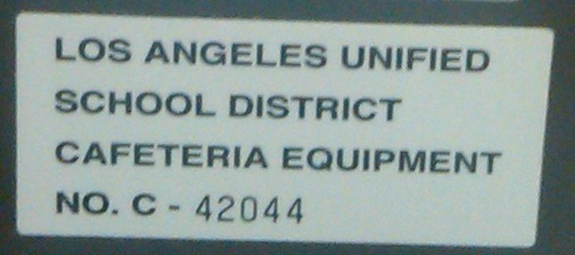
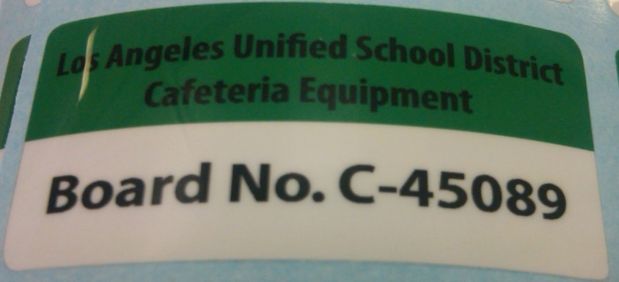
Examples Of Board Number Information

Slide 7
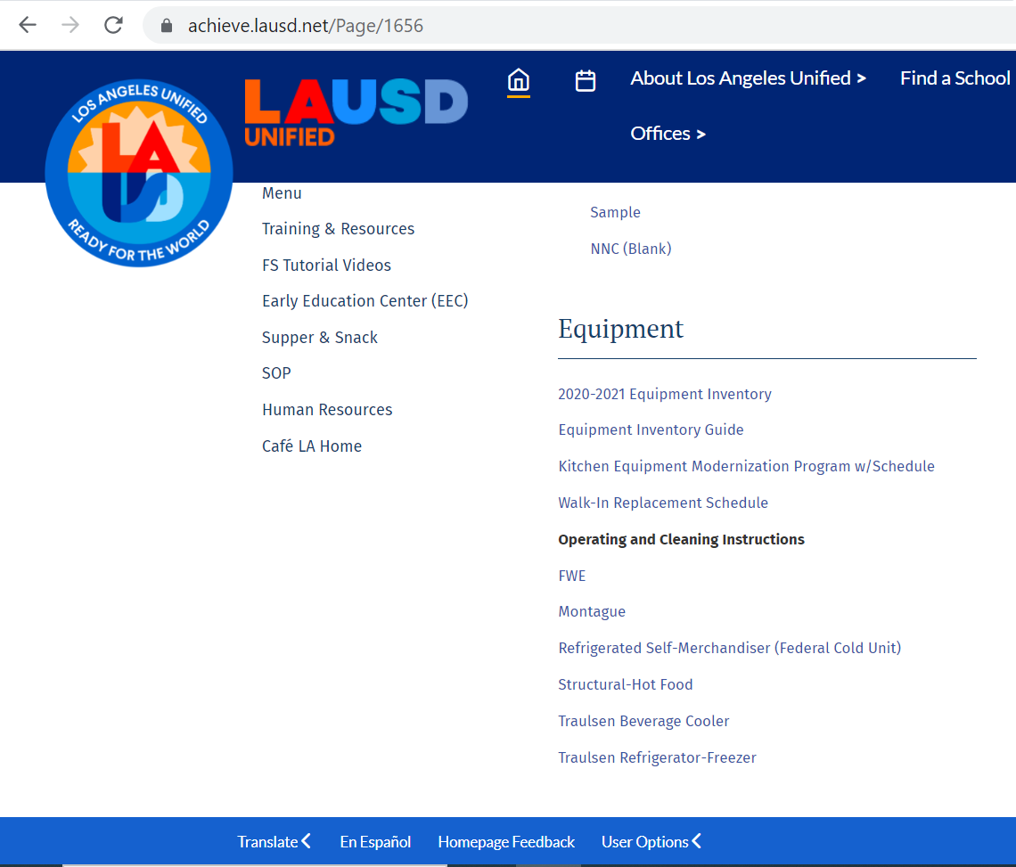
How To Locate The Equipment Inventory
The Equipment Inventory can be located on the food service website.
Step 1: Log into the food service website.
Step 2: Click Training & Resources Tab.
Step 3: Scroll down to Equipment section and select 23-24 equipment Inventory.
Step #1
Step #2
Step #3
2023-2024

Slide 8
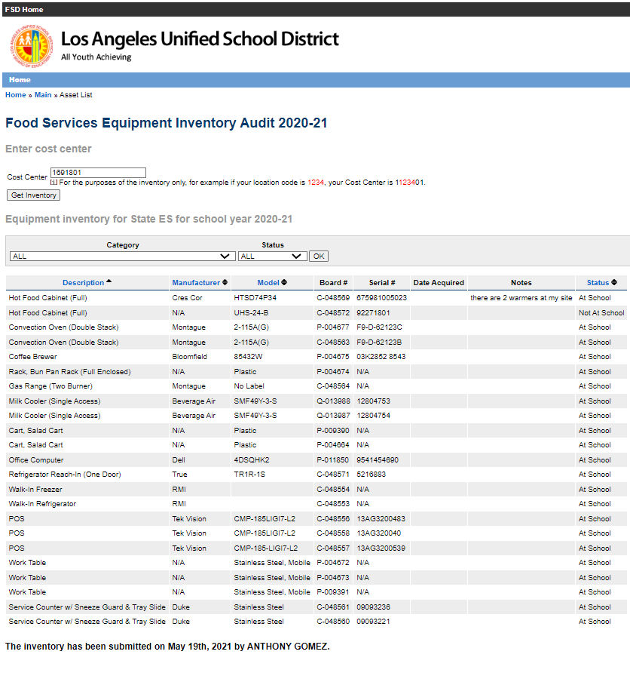
A Sample Inventory Report
2023-24
2023-24
2023

Slide 9
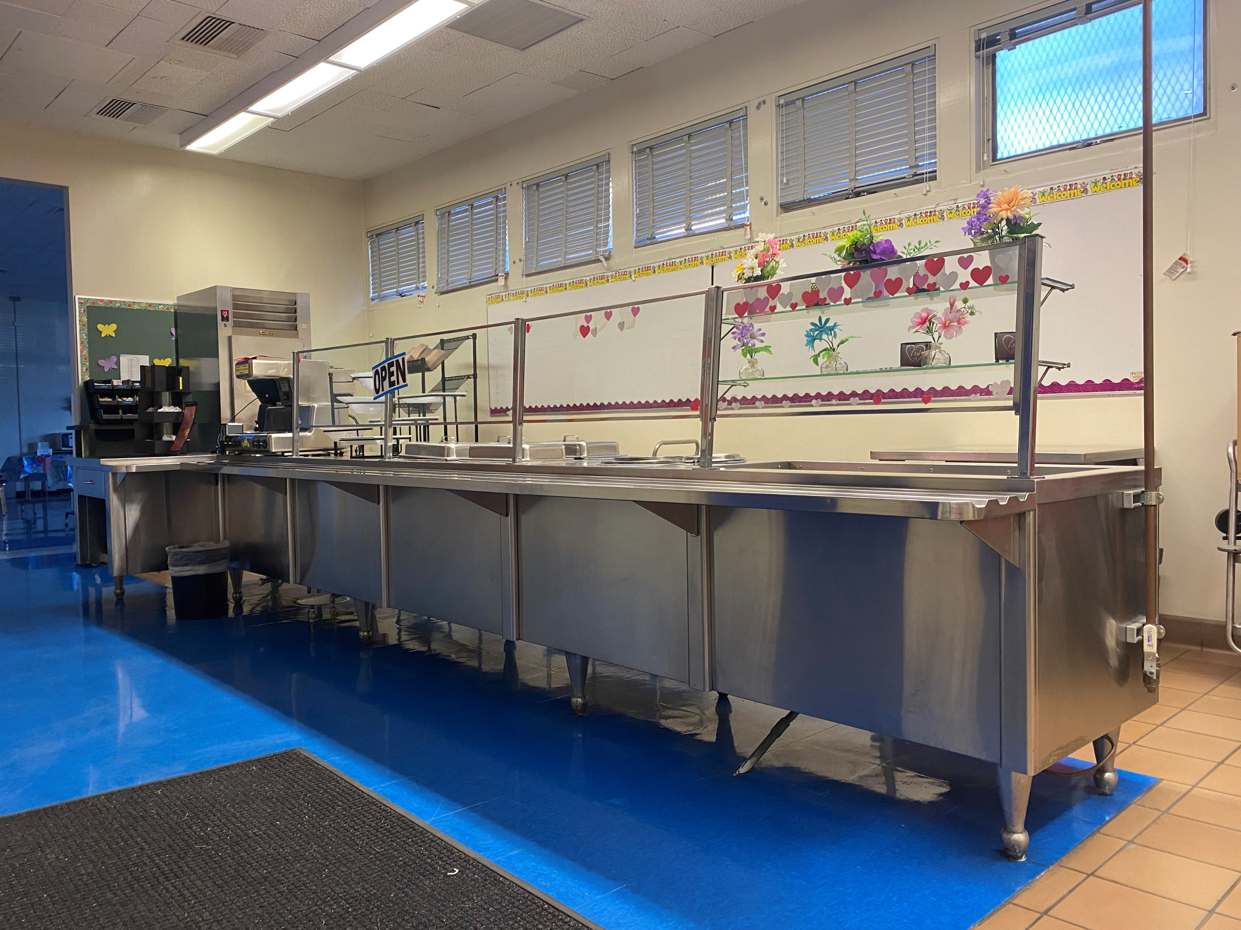
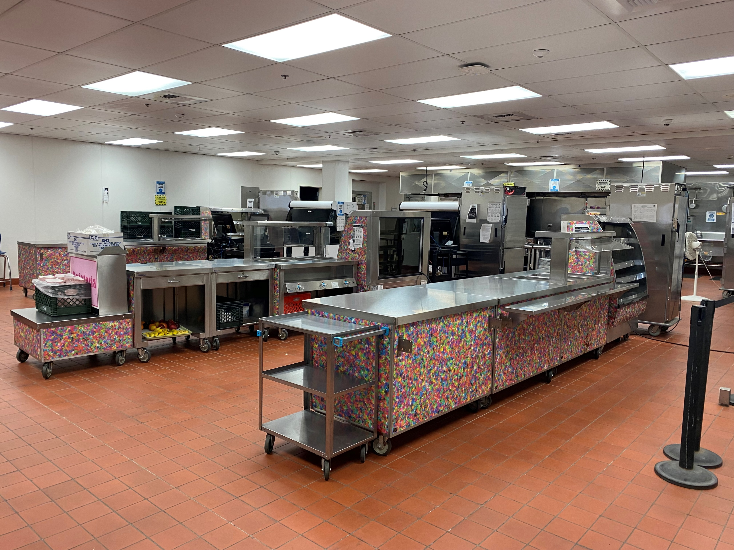
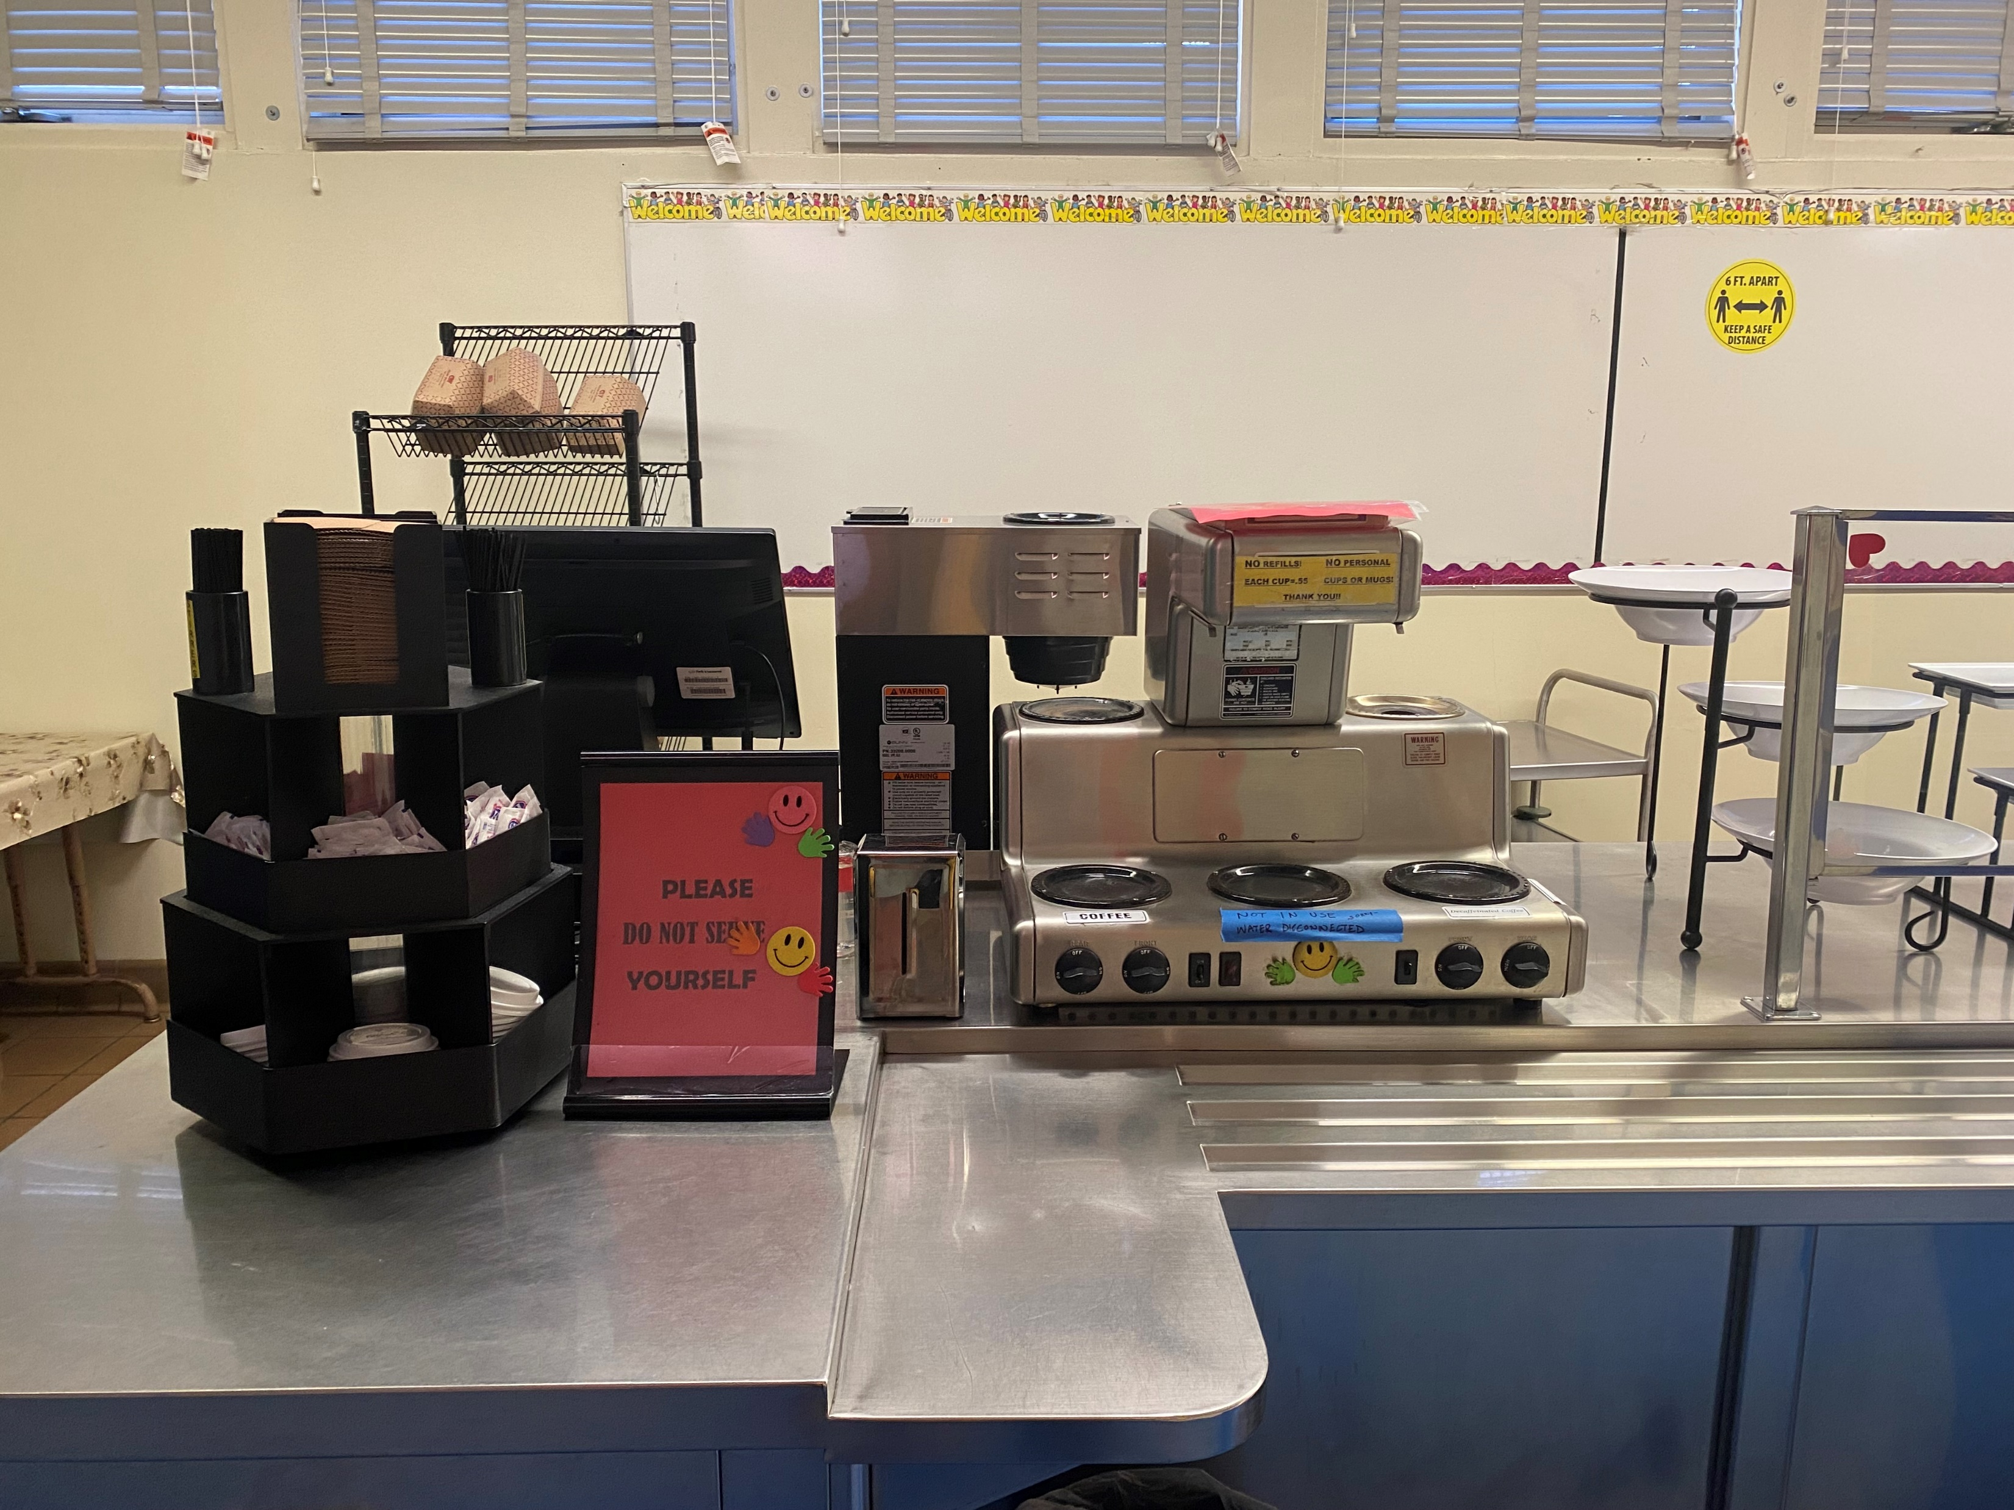
Kitchen Equipment With Serial, Model, And Board Number Locations

Slide 10
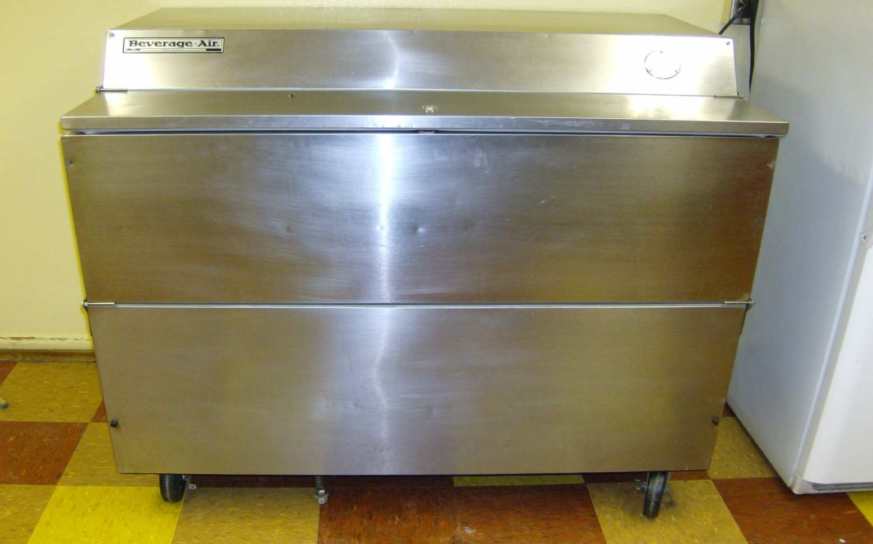
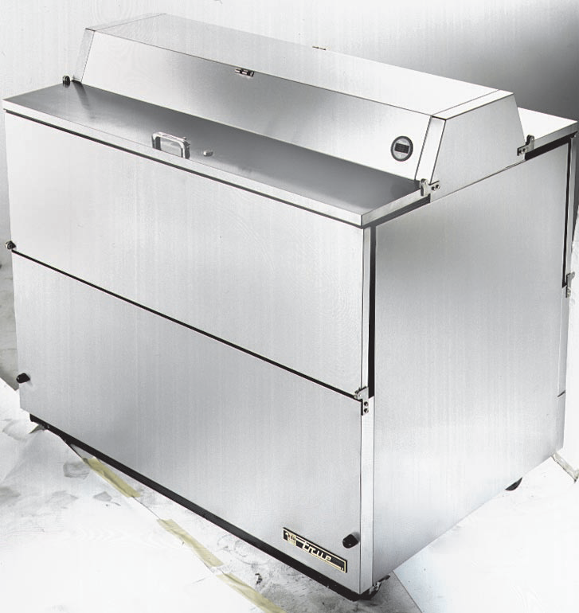
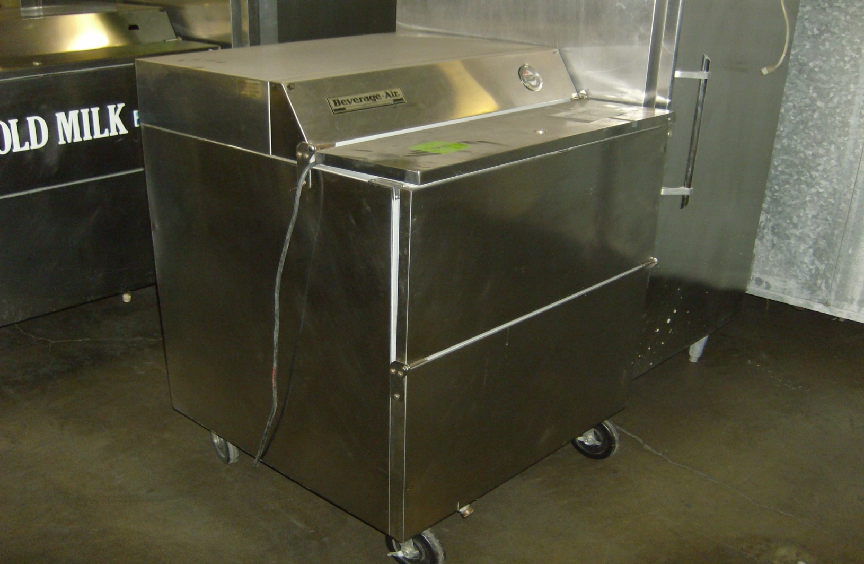
Beverage Cooler Descriptions
Three typical models:
34” Single Access
49” Single Access
49” Dual Access

Slide 11
34” Beverage Cooler SINGLE ACCESS

Slide 12
49” Beverage Cooler SINGLE ACCESS

Slide 13
49” Beverage Cooler DUAL ACCESS

Slide 14
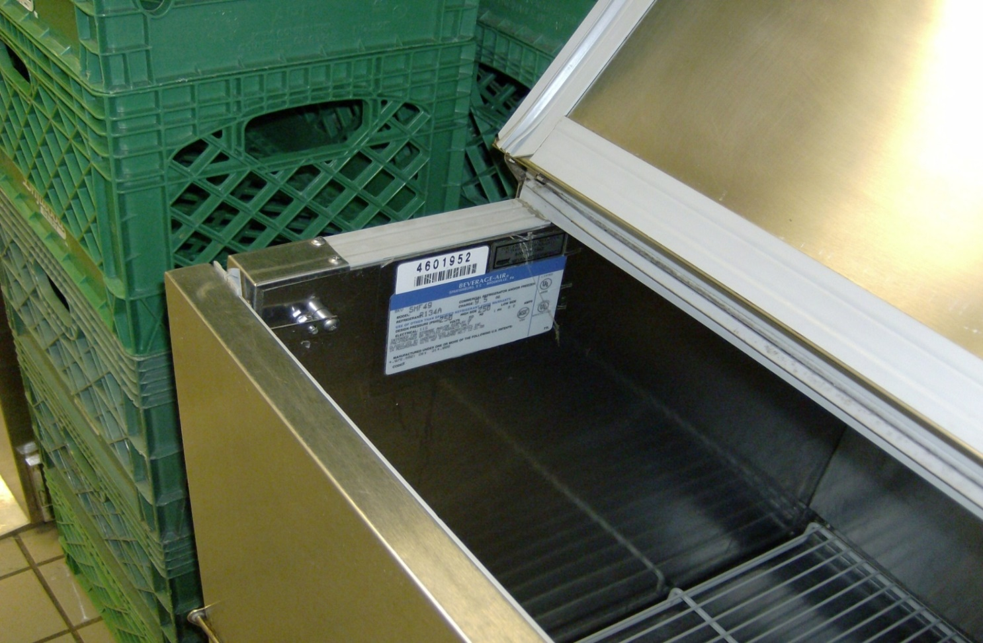
Beverage Cooler
Model and Serial #’s are located on the left inside panel.

Slide 15
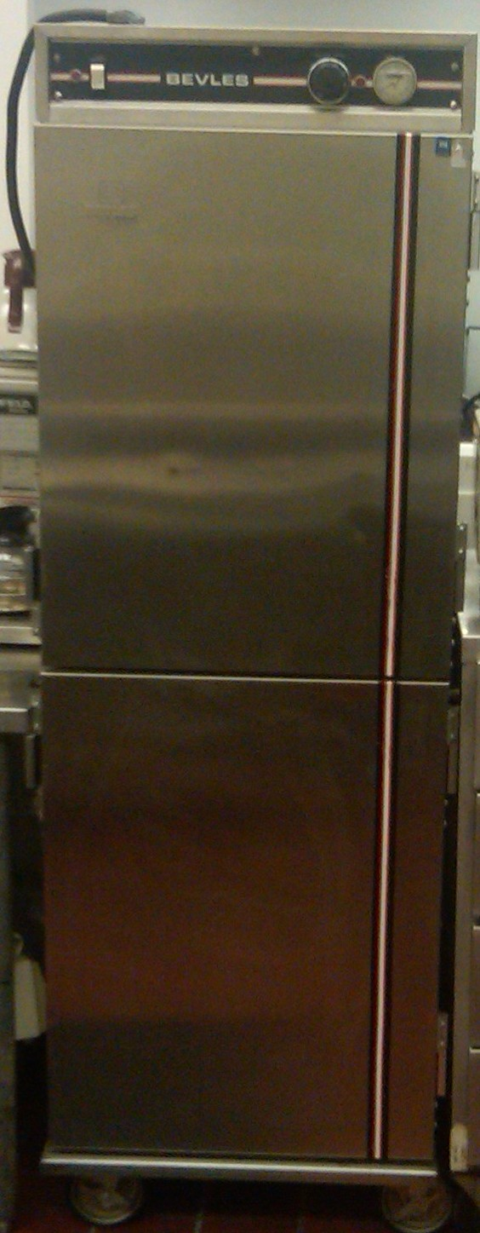
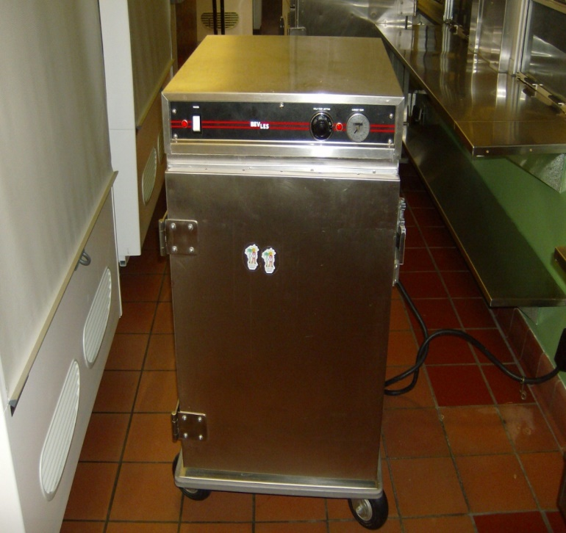
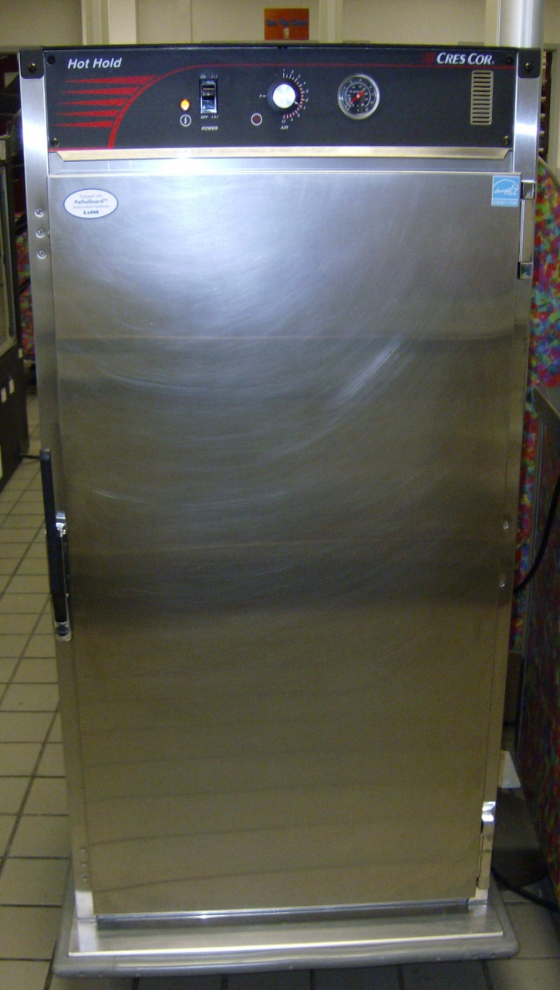
Hot Food Cabinets
Three Typical Models:
½ Size
¾ Size
Full Size
Full Size
½ Size
¾ Size

Slide 16
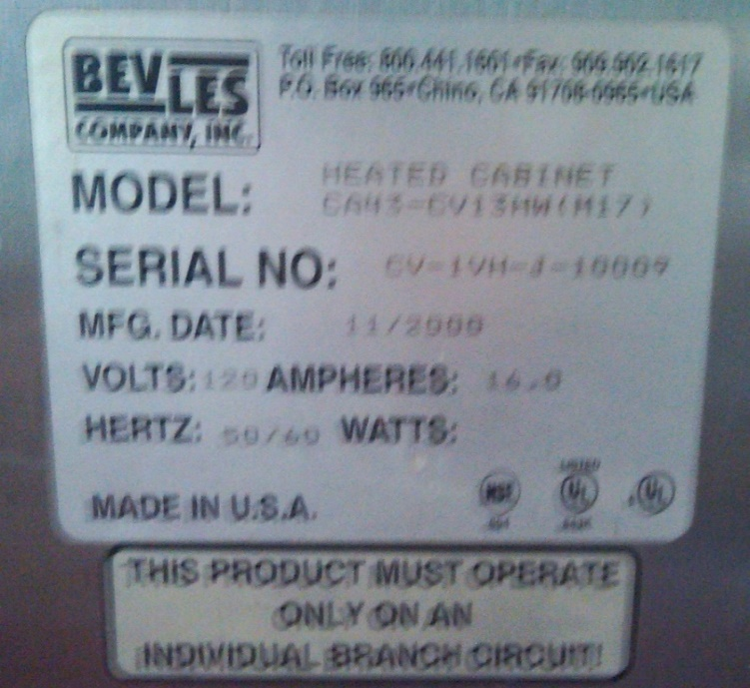
½ Size Hot Food Cabinet
Model and Serial #’s are located on the side of unit.

Slide 17
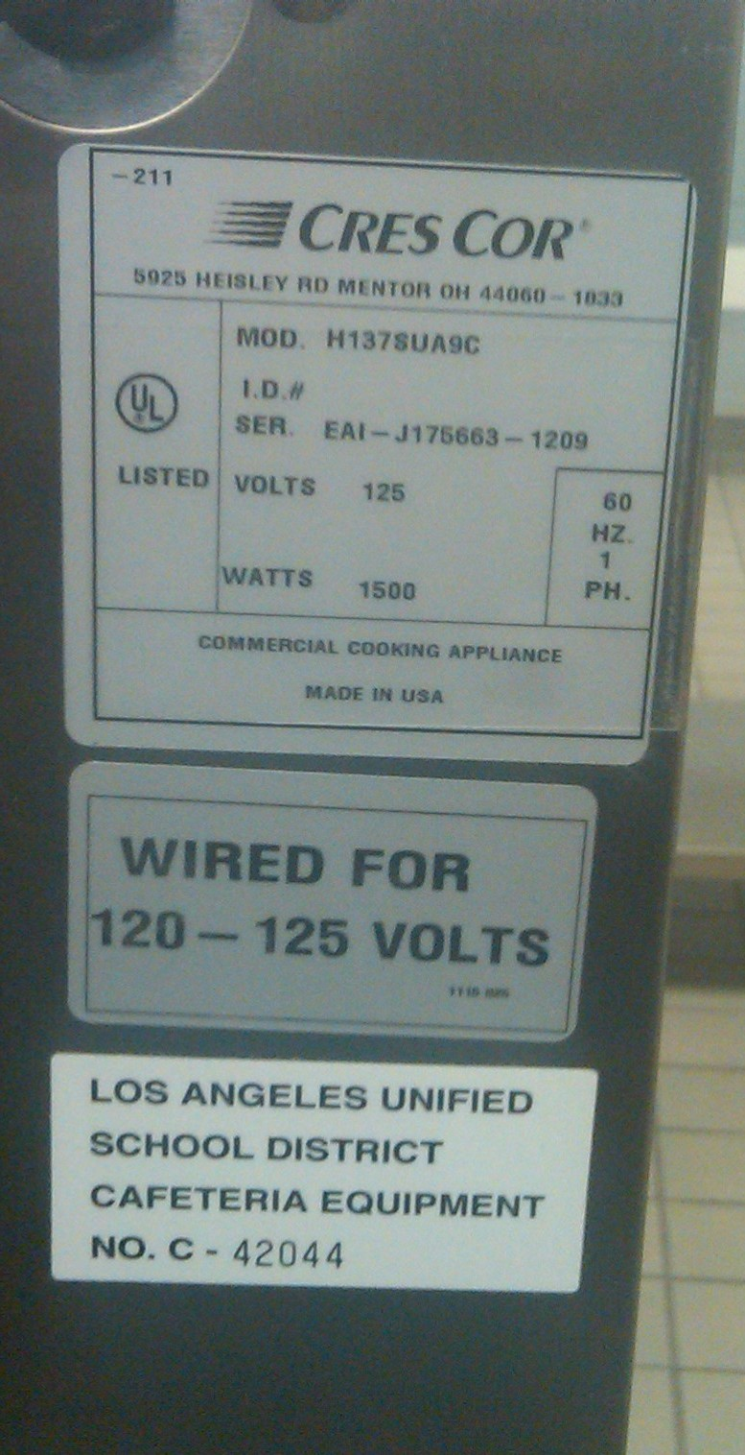
Model and serial #’s are located on the back of the unit.
¾ Size Hot Food Cabinet
Look behind unit for #

Slide 18
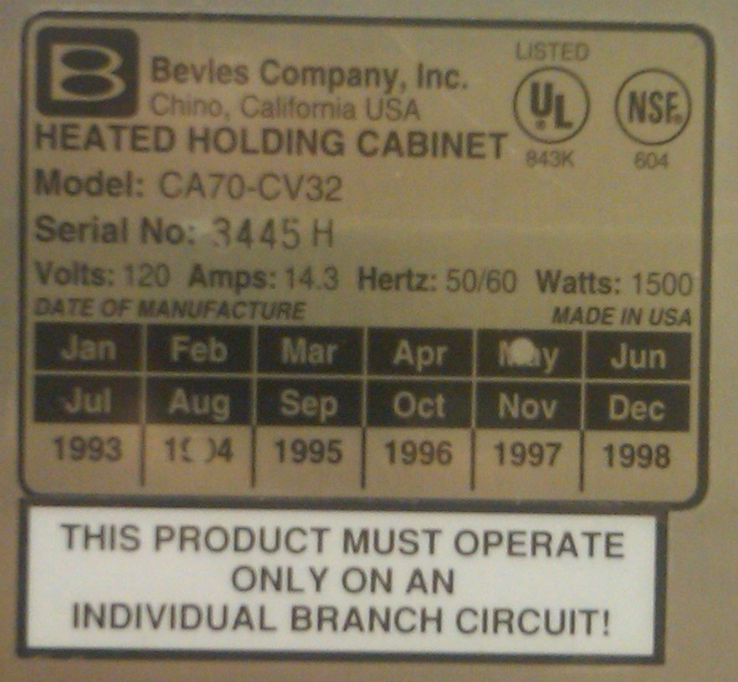
Full Size Hot Food Cabinet
Model and Serial #’s for Full Size are located:
on the right-hand side or back of the unit.

Slide 19
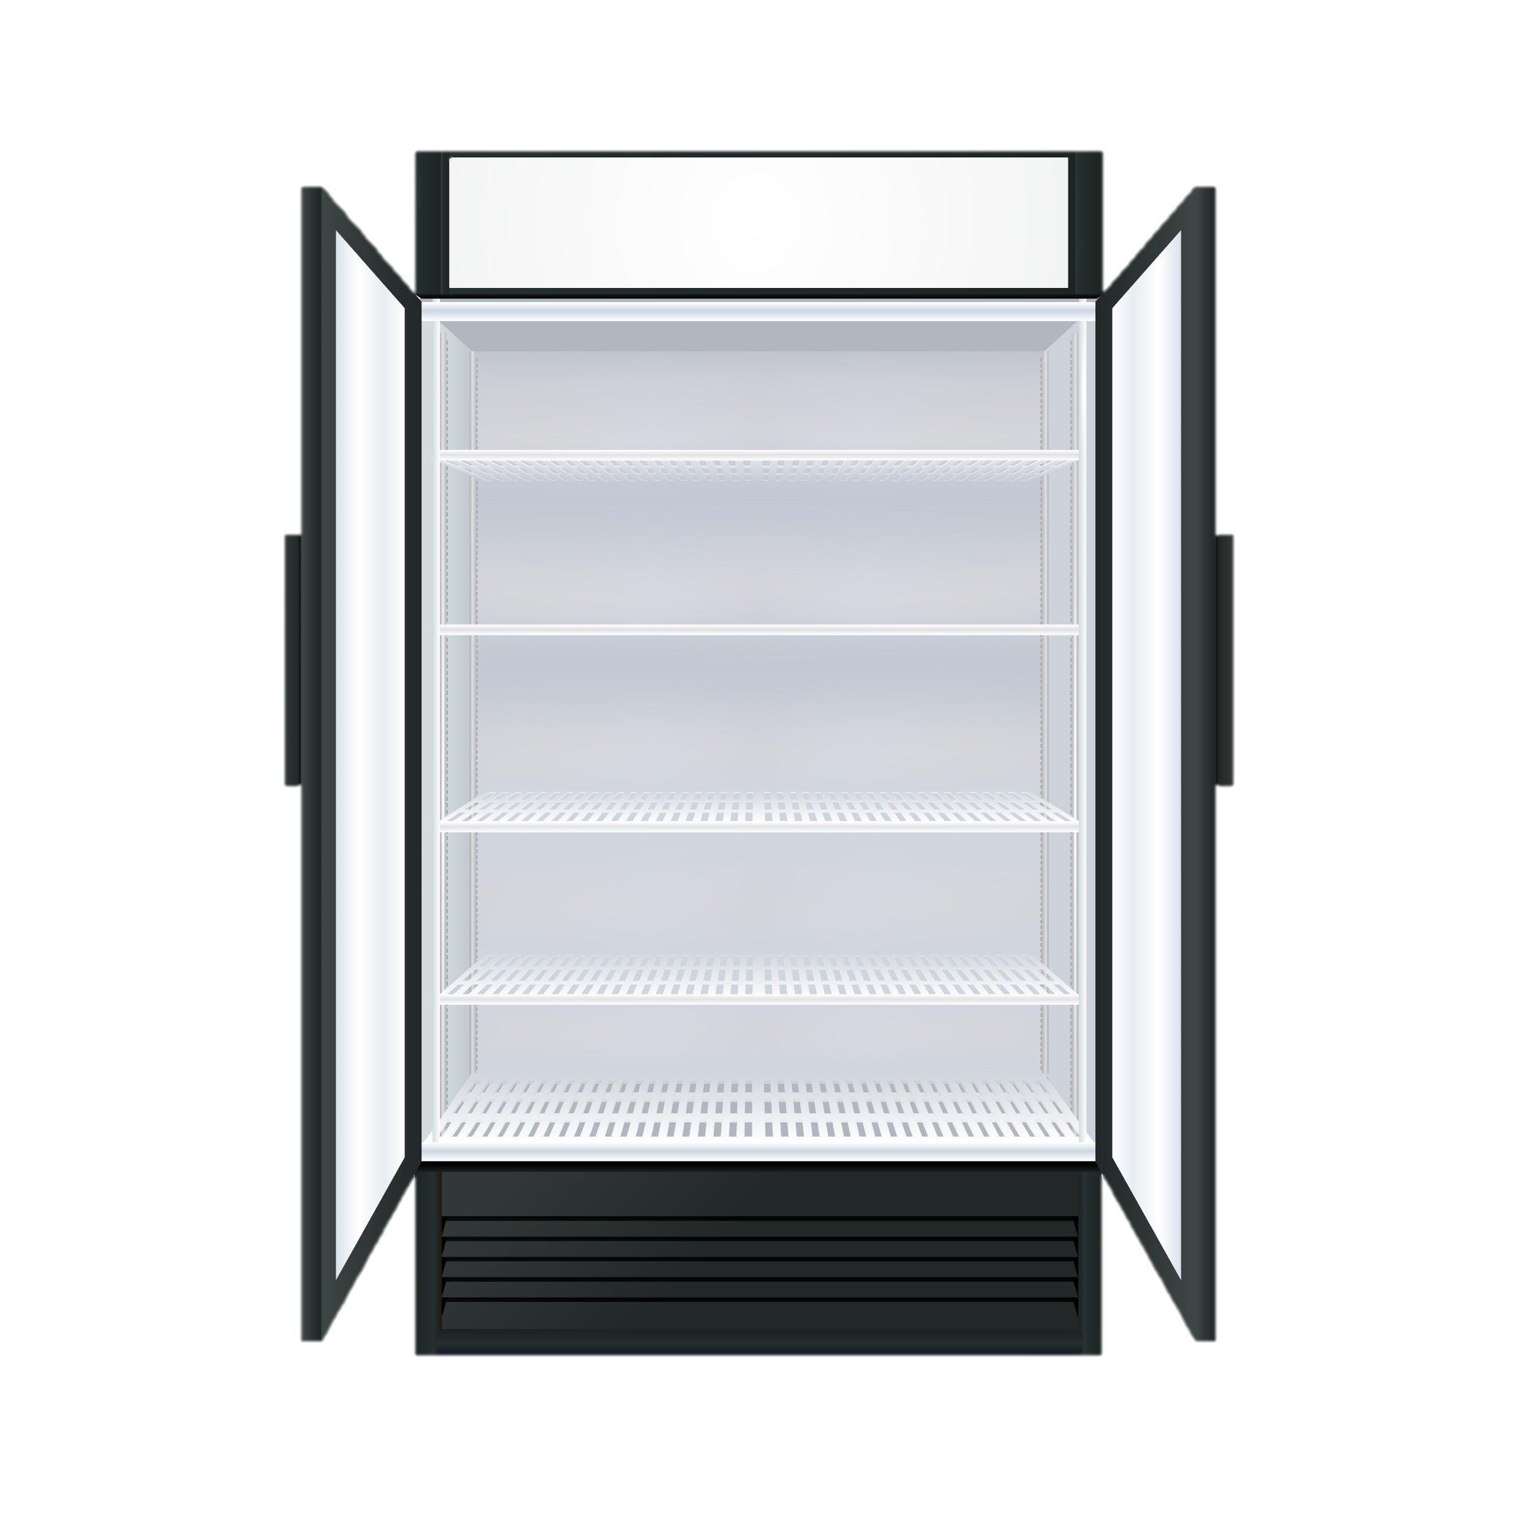
Refrigeration
6 Typical Fridge Models
One Section Reach-in
One Section Roll-in
Two Section Reach-in
Two Section Roll-in
Three Section Reach-in
Four Section Reach-in

Slide 20
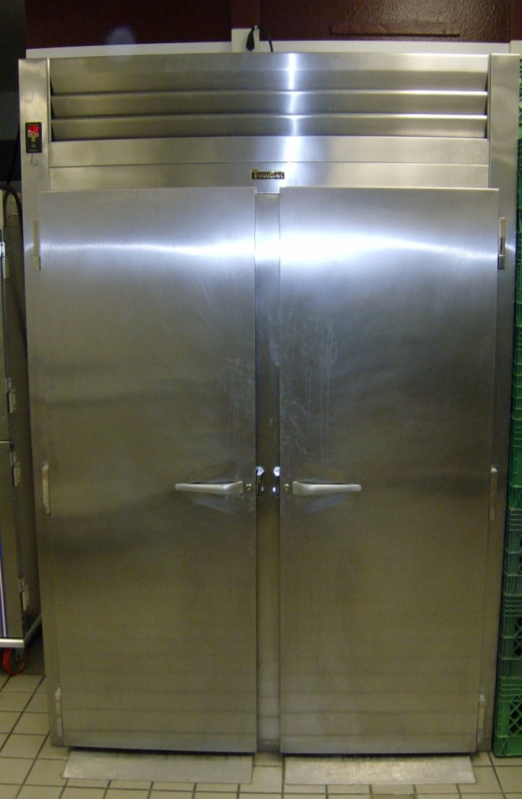
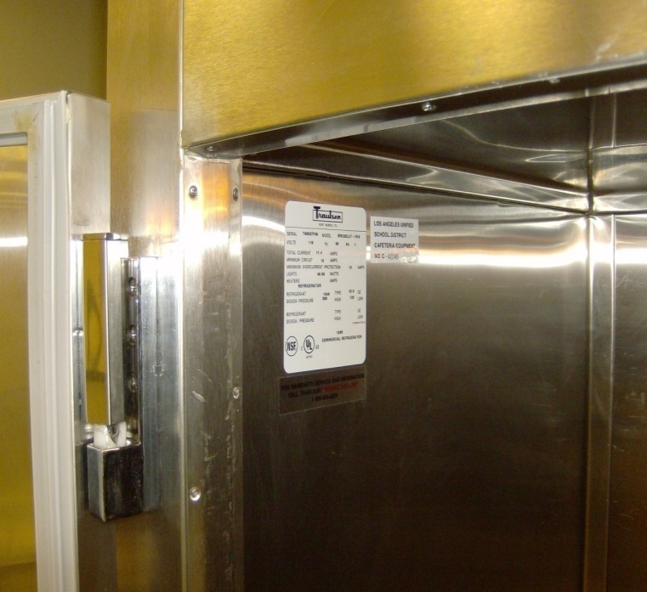
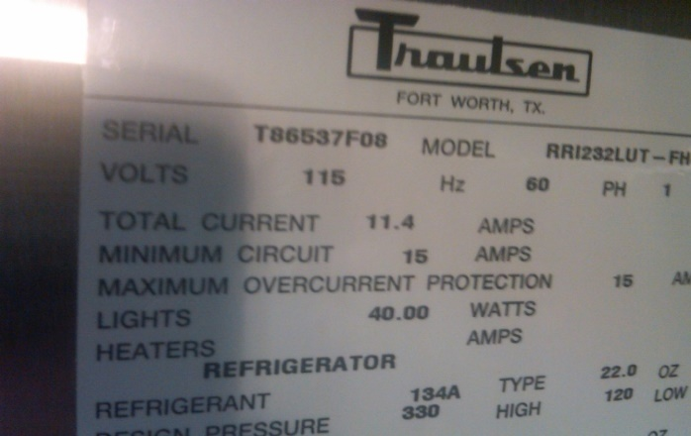
Reach-In/ Roll-In
Model and Serial #’s are located: on the inside upper left or upper right wall.

Slide 21
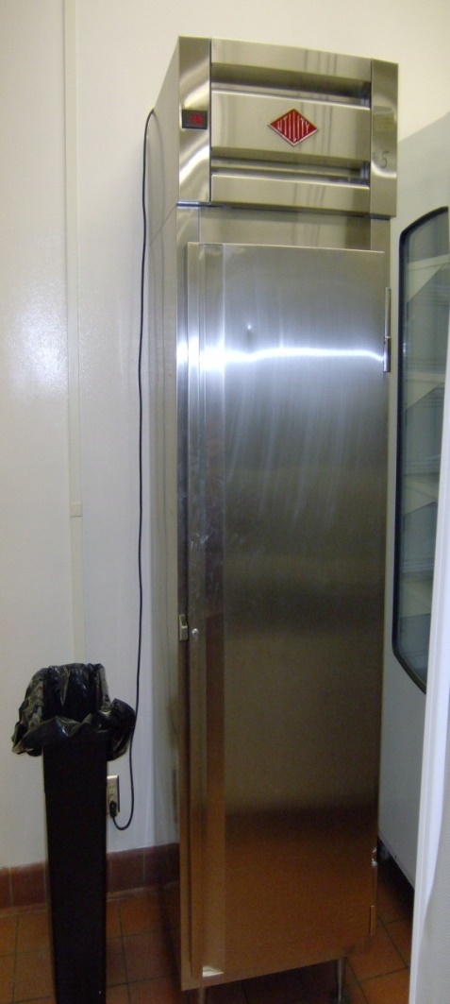
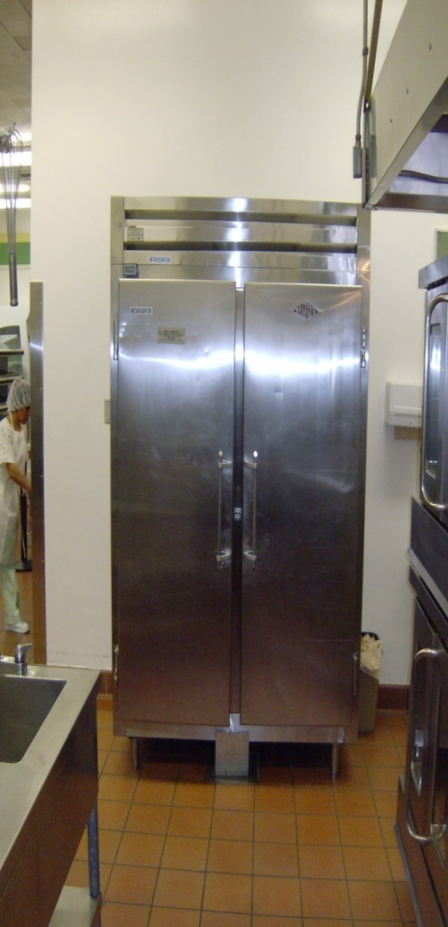
Freezers
5 Typical Freezer Models
One Section Reach-in
Two Section Reach-in
Three Section Reach-in
Four Section Reach-in
Spot Freezer
(“Ice-cream freezer”)

Slide 22
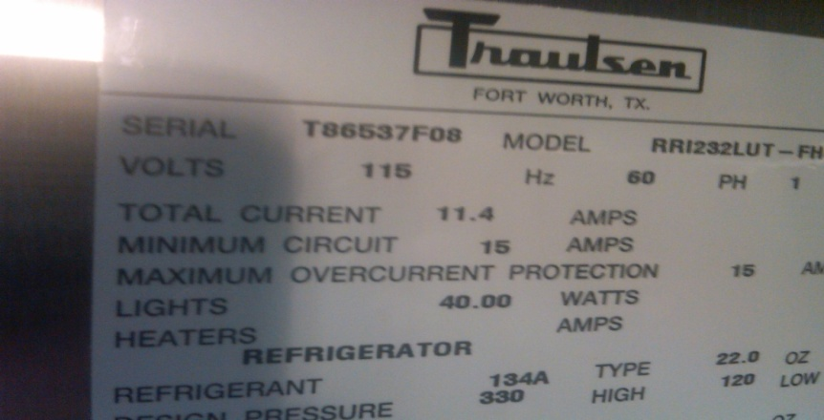
Model and Serial #’s of Reach-in Freezers located: on the inside upper left/right wall

Slide 23
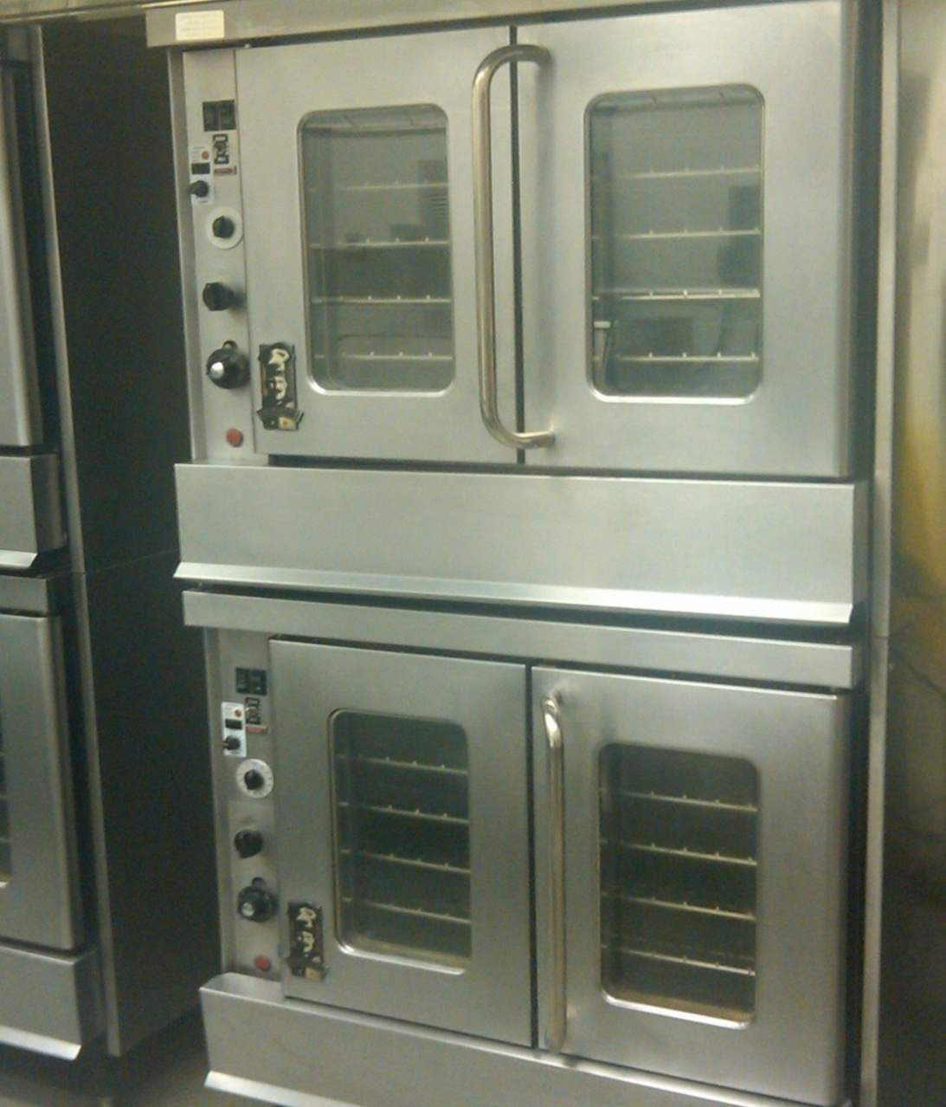
Ovens
4 Typical Models
One Compartment
Two Compartment
Conveyor
Combination
NOTE:
When inventorying a two-compartment oven, ONE Board number is provided for both compartments
Remove to locate Model and Serial #.
One board number for
Both compartments.

Slide 24
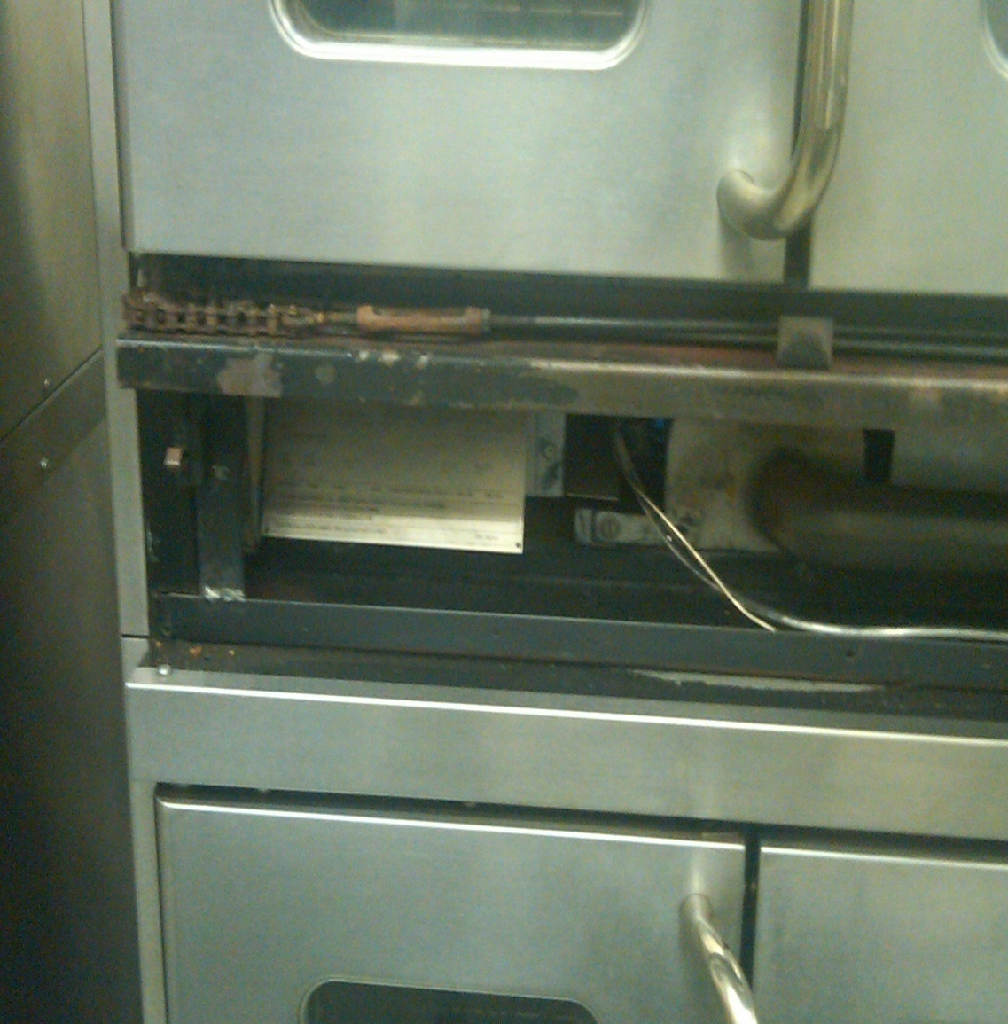
Model and serial number for ovens are found by pulling (top or bottom) front burner panel off to view information.
Remove carefully

Slide 25
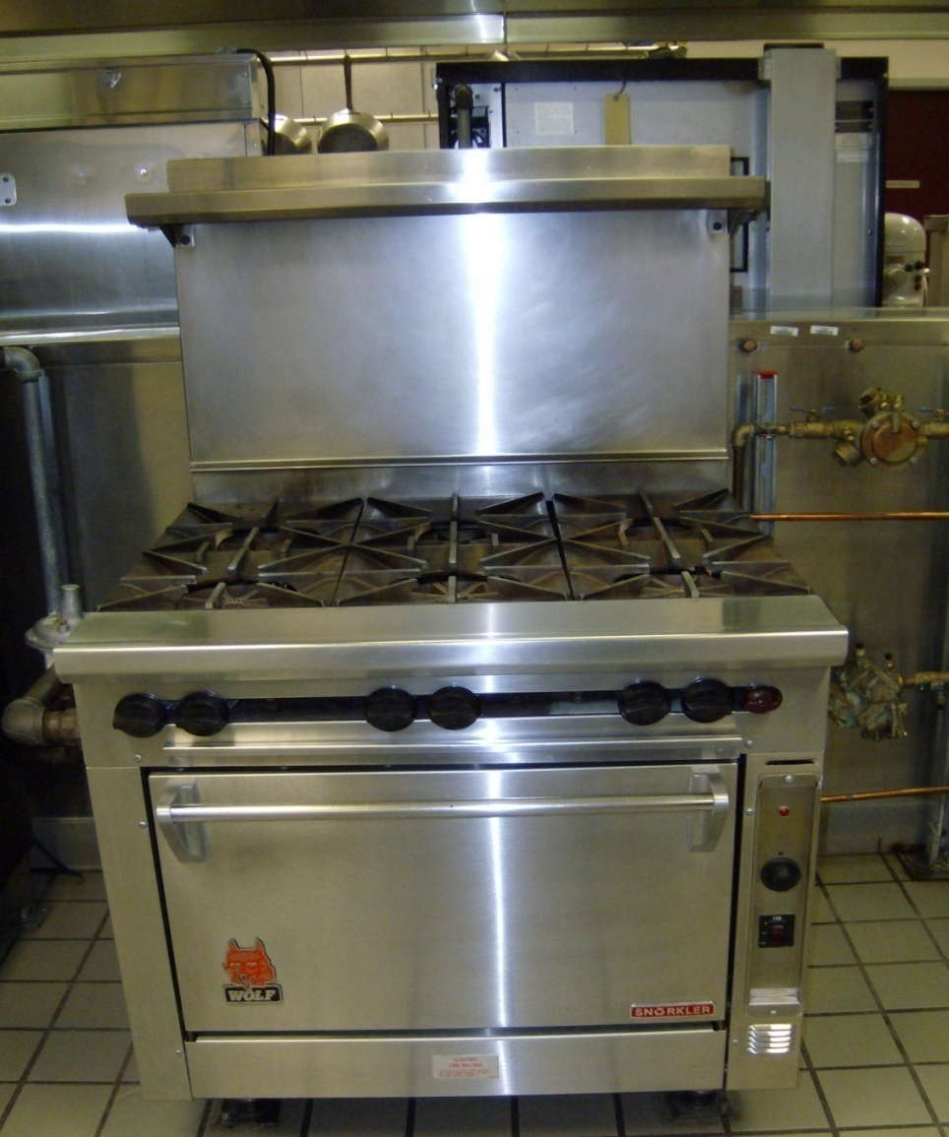
Ranges
3 Typical Models:
Two Burner
Four Burner
Six Burner w/Oven
NOTE: Remove bottom panel for Model and Serial numbers
Remove

Slide 26
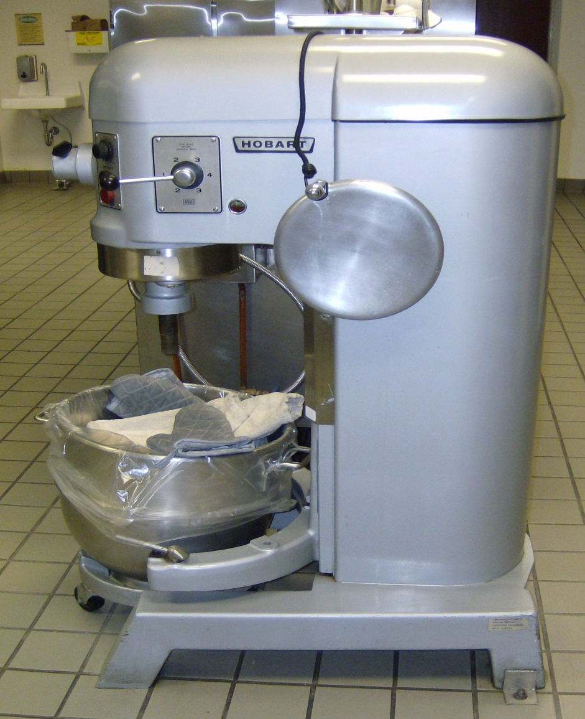
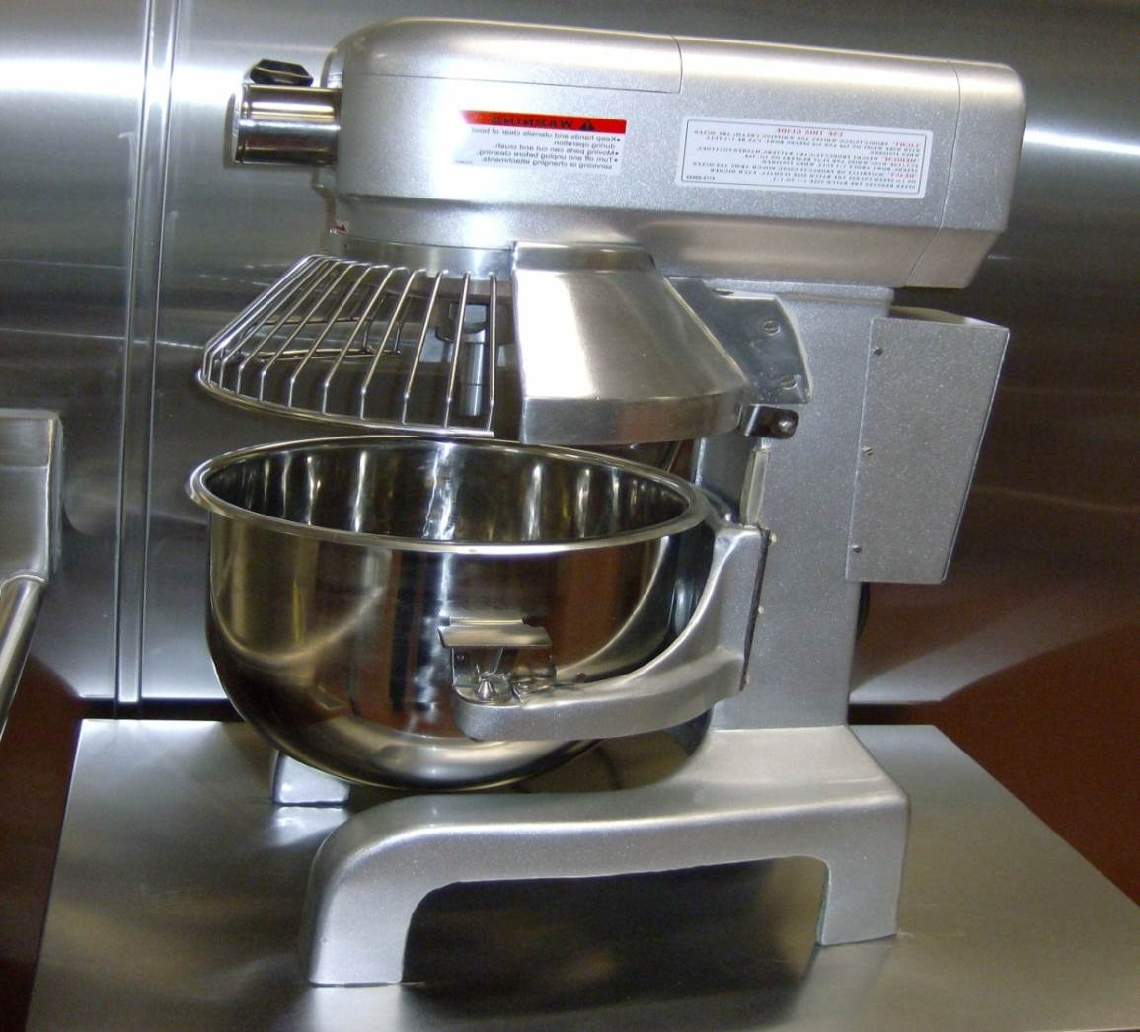
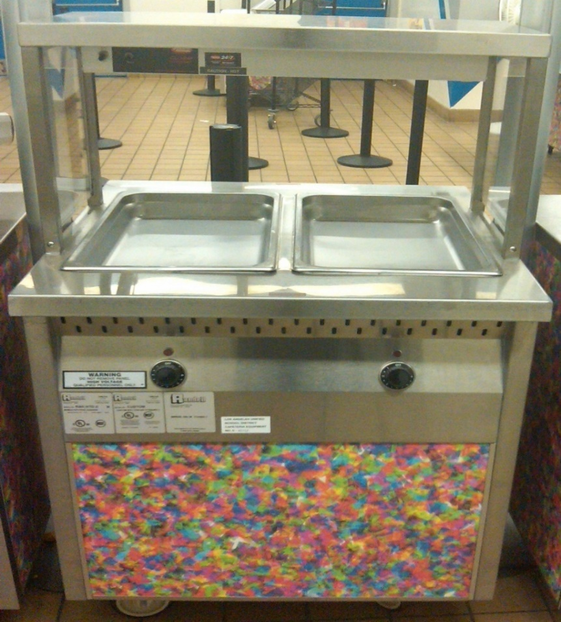
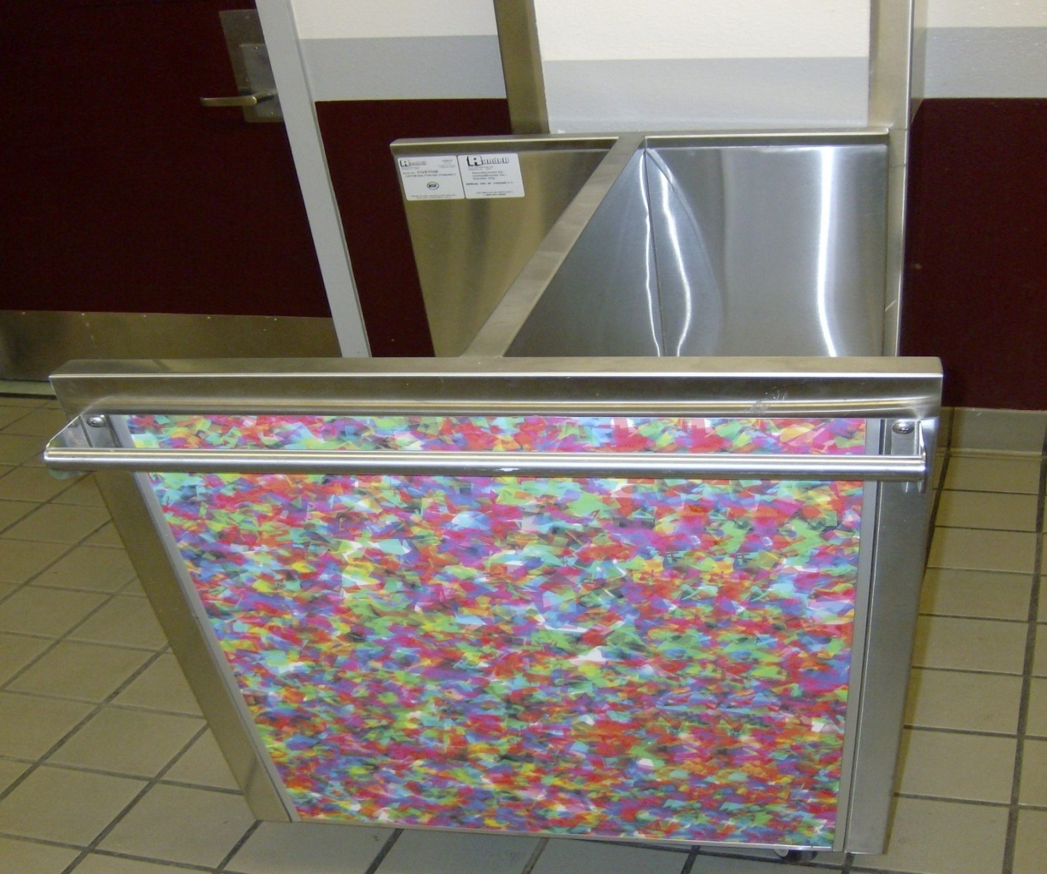
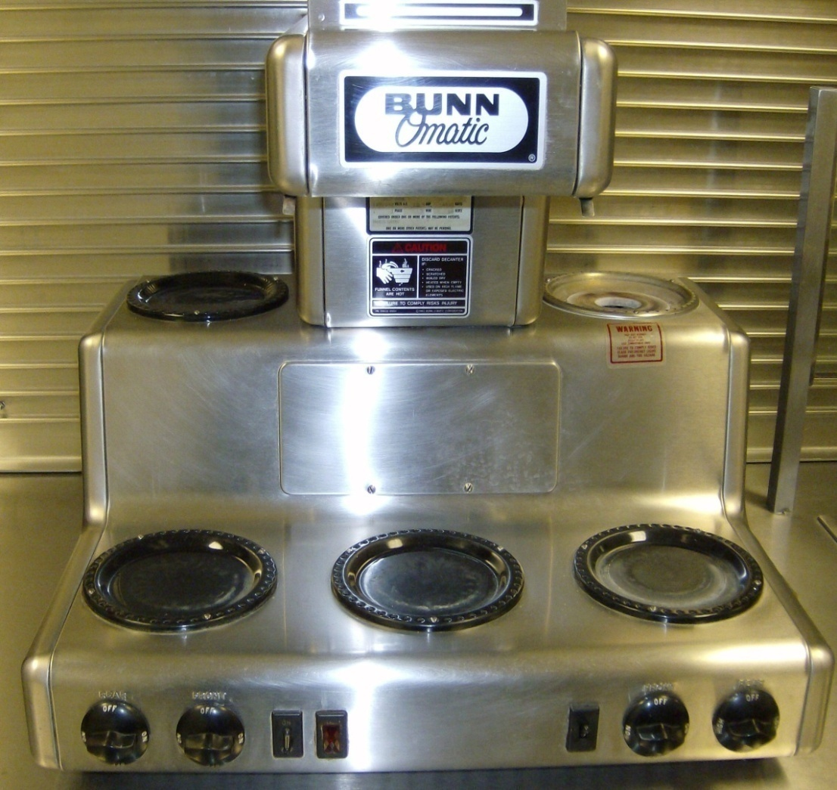
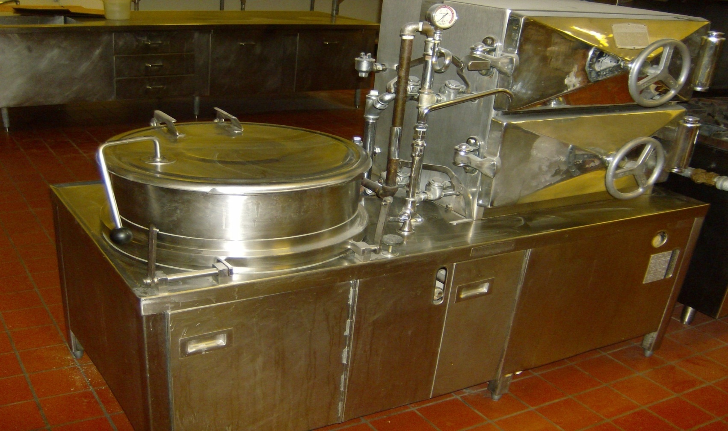
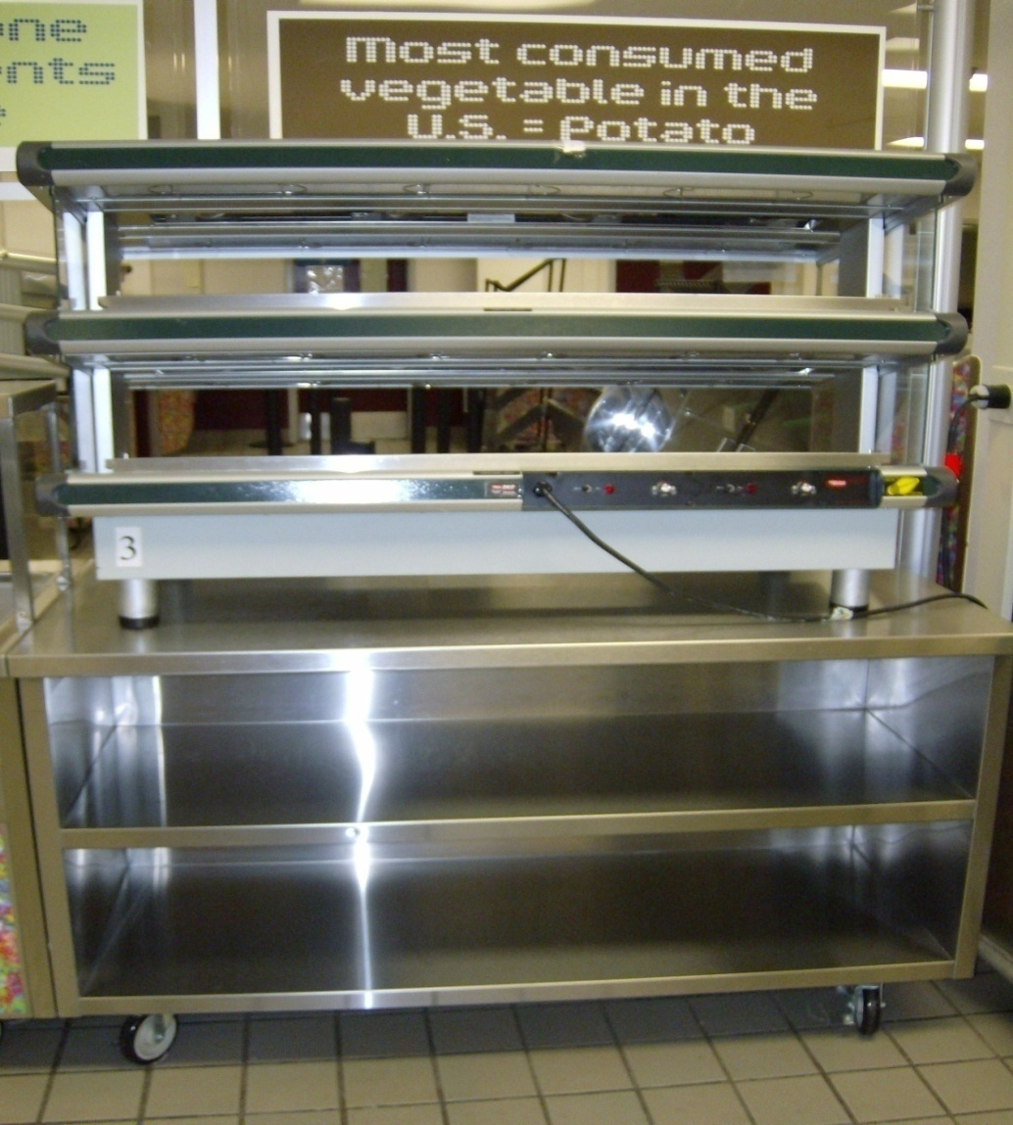
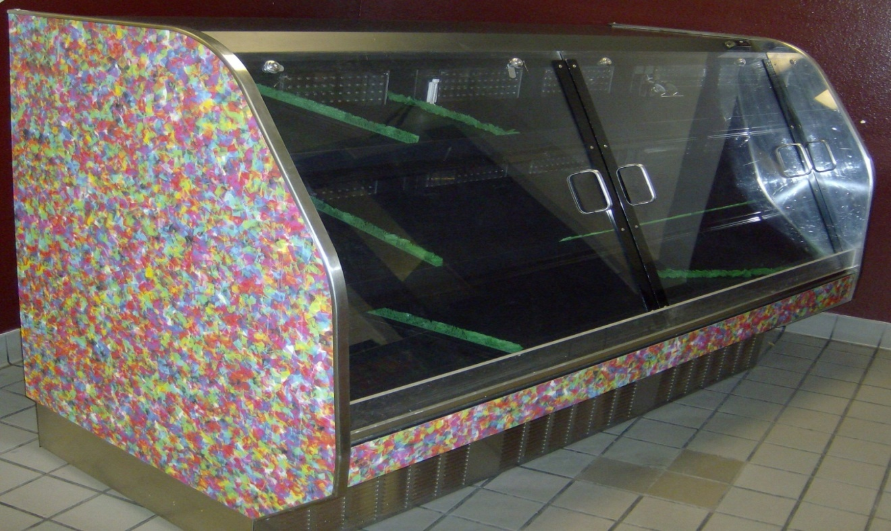
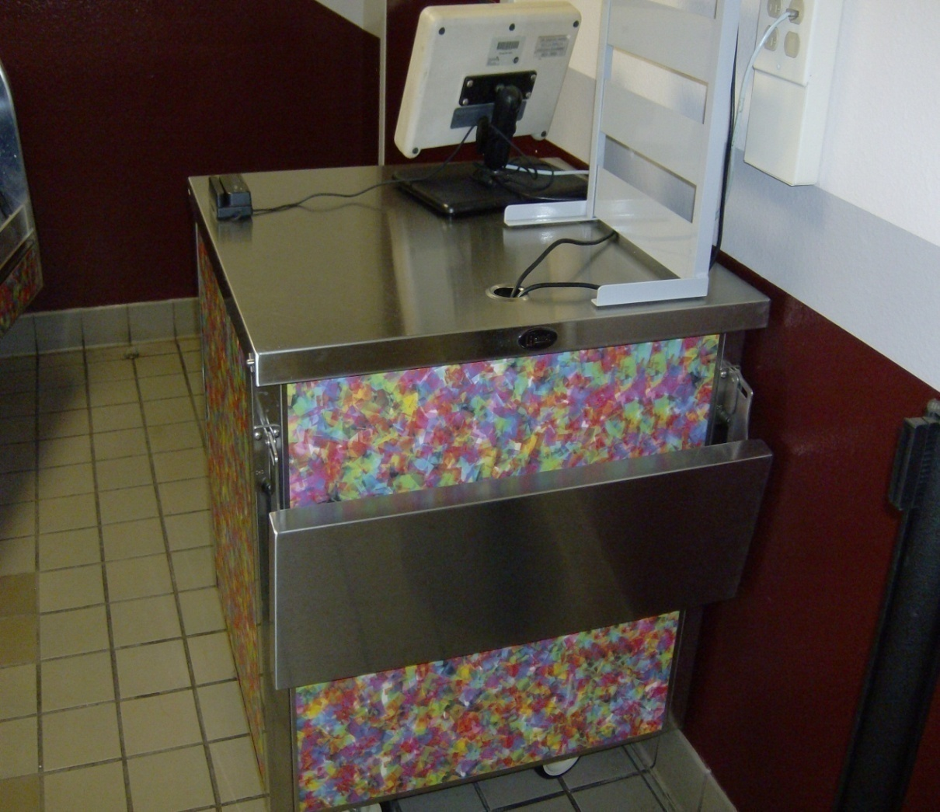
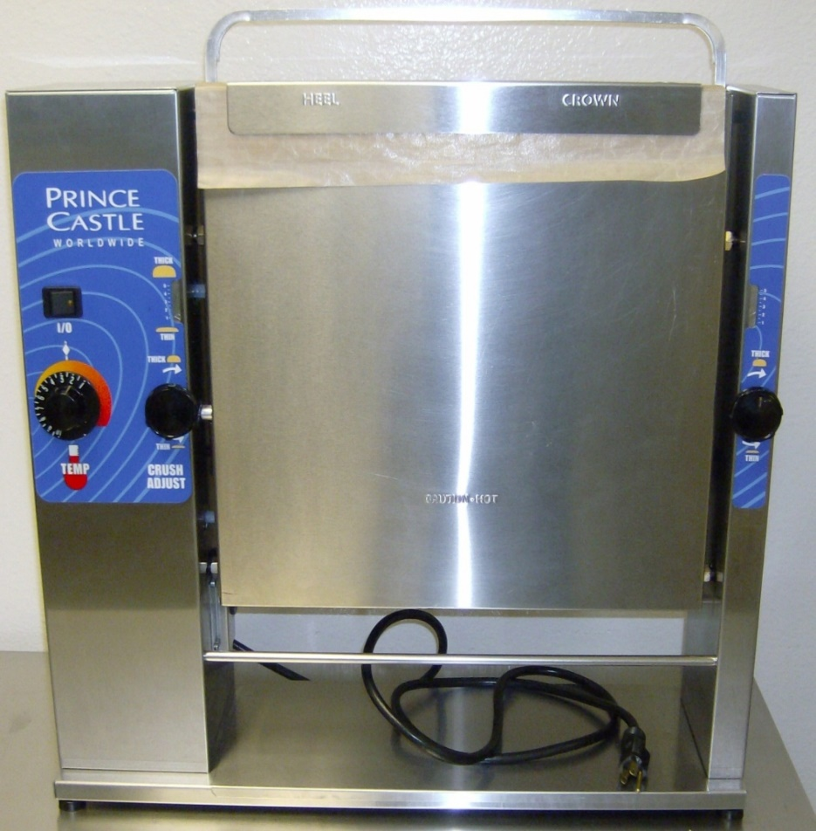
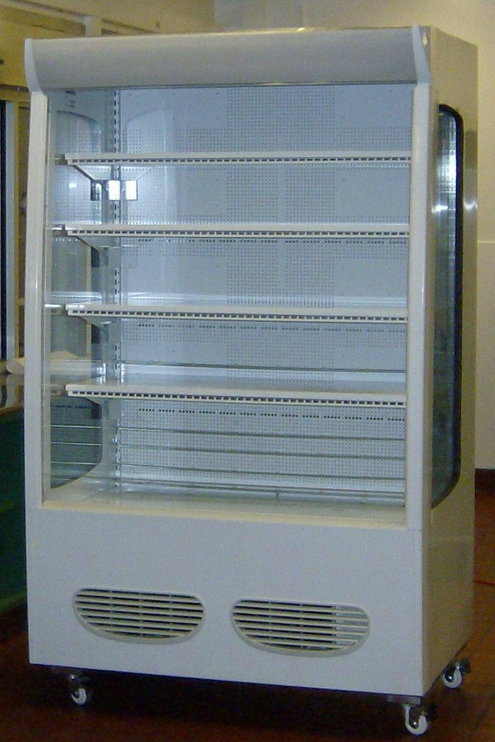
Additional Cafeteria Equipment
There is additional equipment you will have to inventory, depending on your school site and service you provide.

Slide 27
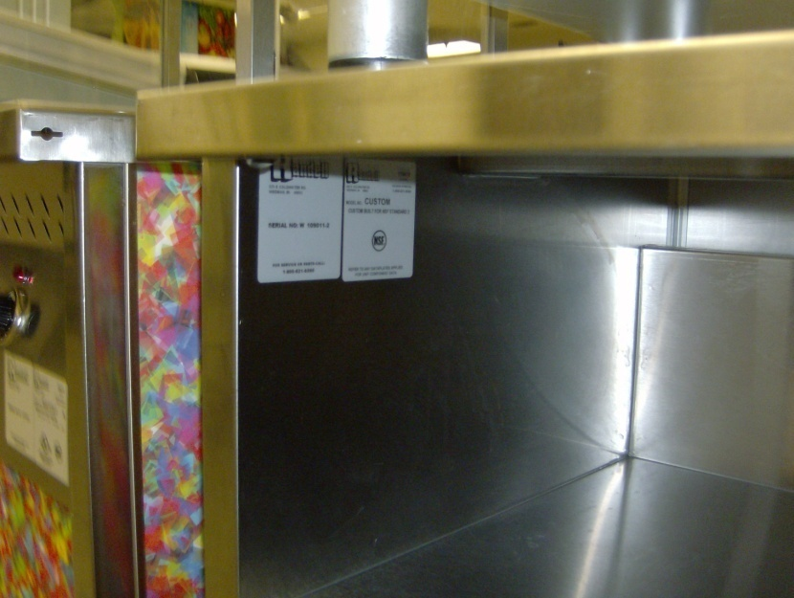
Cashier Stand And Condiment Counter
Model and Serial numbers are located on the inside wall of the unit.

Slide 28
Tray Holder
Model and Serial numbers are located on the inside wall of the unit.

Slide 29
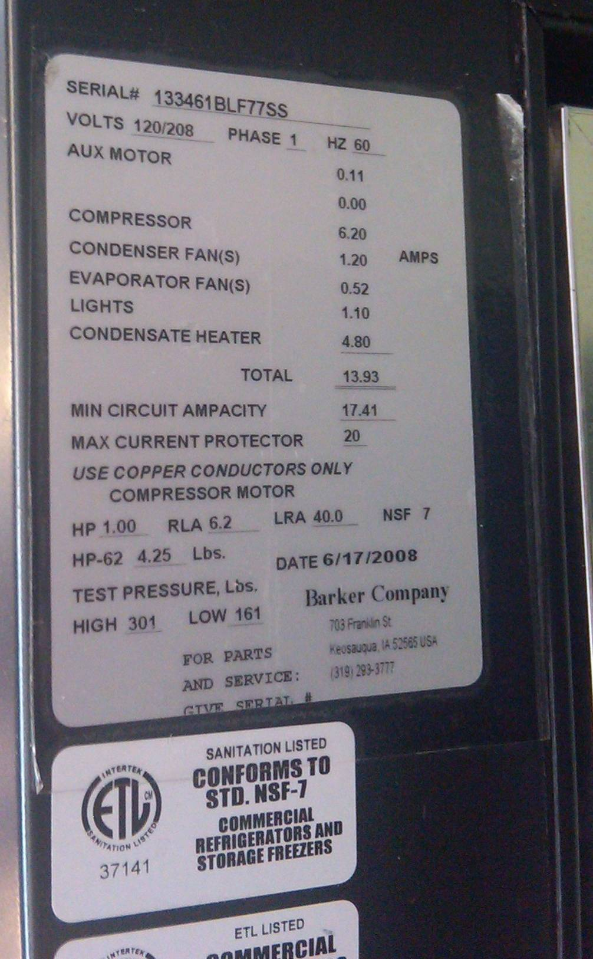
Cold Merchandiser
Model and Serial #’s are located on the back of the unit, the model type is indicated in the Serial number.

Slide 30
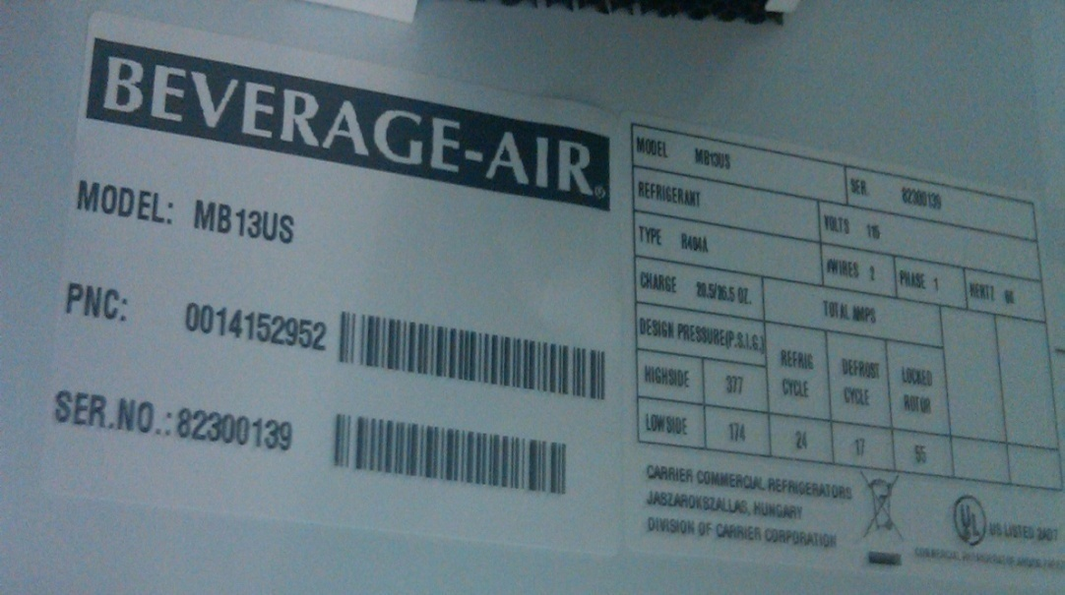
Refrigerated Open Air Merchandiser
Model and Serial number located on top panel the inside.

Slide 31
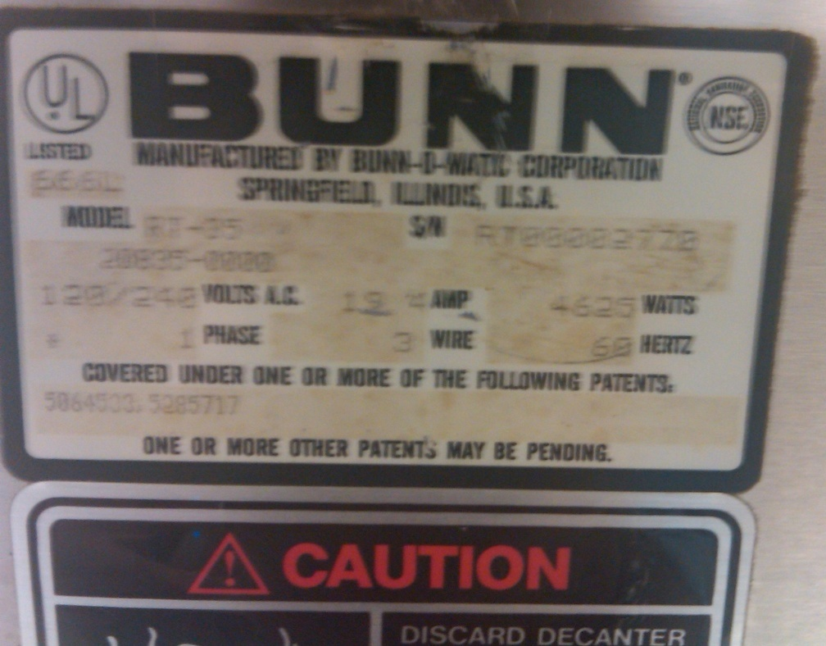
6 Burner Coffee Maker
Model & Serial #’s are located in front of the unit.

Slide 32
60 Quart Floor Mixer
Model and Serial number located on the back of the unit.

Slide 33
20 Quart Mixer
Model and Serial #’s located on the back of the unit.

Slide 34
2-Well Hot Food Serving Counter
Model and Serial Numbers are located on the back of the unit.

Slide 35
Slant Rack Hot Merchandiser On 60” Counter
Model and Serial numbers located here.

Slide 36
Bun Toaster
Model & Serial # are located on the back of the unit.
Look behind unit.
Look behind unit.

Slide 37
Steamer / Kettle
Model and Serial #’s can be found in two places in the front right panel or the surface.

Slide 38
Immersion Blender
Serial # Located On Handle make and model located in front of the blender.

Slide 39
Share Cart
Make, Model, & Serial # are located on either the left or right side of the unit.
Look at both sides of the unit

Slide 40
Hot Water Dispenser
Serial & Model # is located on the back of the Hot Water System.
Please make sure you haven’t used the unit in the past hour when trying to locate your serial & model #
Look Behind Unit

Slide 41
Food Processor
Serial & Model # is located underneath the unit
Please have NO BLADES inserted when locating the serial & model #

Slide 42
Knife Sharpener
Serial & Model # is located underneath the unit
Please have the unit unplugged before locating your serial & model #
Look Underneath Unit

Slide 43
Combi Oven
Serial # and Model # can be located on the interface screen

Slide 44
After Inventory Is Completed
Review:
Site’s inventory is logged on the date received.
Information is updated.
What To Expect:
Updated Inventory Report will be mailed to the Food Service Manager by the Equipment Section for their reference.
Cafeterias will be selected randomly to verify information. accuracy.

Slide 45
Equipment Team Contact Info
Name | Email
Jorge Hernandez
Jorge.hernandez5@lausd.net
Albert Gamboa
Albert.gamboa@lausd.net
Ricky Miramontes
Ricardo.miramontes@lausd.net
Questions?

